Slide 1


Avnet & AWS Data Center Automation
AWS PDM: Andrew Howard, anhowad@amazon.com
Avnet AM: Jen Dixon, jen.dixon@amazon.com
FIELD ENGAGEMENT PROGRAMS: ACE, ISV-A, MAP, AWS Marketplace | CERTIFICATIONS / COMPETENCIES: Foundational: 22, Technical: 9, Pro 3 / ISV & HW IoT Comp., Gen AI and M&M (MAP) Comp’s in process | APN PARTNER LEVEL:, SW/ISV FTR and Differentiated, HW (Validated, 11 devices qualified) and Services Path (Advanced Tier) | SPMS ID: 1840025
KEY SUMMARY QUESTIONS
What is the customer issue or opportunity?
Data center operators run fragmented stacks—BMS for cooling, DCIM for rack power, SCADA for electrical—none of which talk to each other, while technicians still walk manual rounds. Unplanned failures cost ~$9,000 per minute of downtime, and energy regulations (EU EED) now demand verifiable PUE figures. Customers need an automation layer that unifies telemetry, predicts failures, and operationalizes IoT on AWS.
How does the APN Partner address the issue or opportunity?
SIMPLIFY Avnet helps customers simplify data center automation. With our IoT and Edge AI solution expertise, SaaS and design/development capabilities, we’ll guide operators to production by taking on part(s) of, or the whole solution, to suit the customers’ needs. ACCELERATE Avnet and their subsidiary Softweb Solutions deliver Data Center Operations Automation (DCOA) on /IOTCONNECT—real-time telemetry, predictive maintenance with digital twins, ITSM, compliance reporting, and Edge AI—deployed in weeks through a structured four-stage rollout. SECURE Customers have peace of mind working with Avnet's development teams, with in-depth knowledge across sensors, edge devices, and secure end-to-end connectivity (X.509 certificates, encryption in transit and at rest, RBAC via Cognito), combined with Avnet’s embedded software and AWS cloud development expertise. SCALE Avnet is the all-in-one partner that can securely scale a data center automation project end-to-end. From sourcing sensors and edge devices to managing endpoints with /IOTCONNECT, the platform replicates from a single 10,000 sq ft site to large multi-site portfolios with the same dashboards.
How do they differentiate themselves?
Hardware, Connectivity , Software, Cloud, and Professional Services - All in One Place Avnet is unique in that it enables operators to solve data center challenges where solutions need all, or any combination of, sensor/edge hardware, /IOTCONNECT SaaS and cloud connectivity, and cloud-side development expertise. Open integrations span BMS, DCIM, SCADA, CMMS, and ITSM (ServiceNow, Jira SM, Freshservice, GLPI)—with AI/ML, GenAI runbooks, visualization, and back-office integration all under one organization.
Where have they been successful?
100 Years of Solving Customers’ Problems Avnet helps operators put data center automation into production—intelligent infrastructure monitoring, predictive maintenance, energy optimization, and incident response automation. Deployed facilities average ~40% fewer human-error incidents, with a 90-day discover-deploy-decide journey and value validated at every stage.
What is the target customer engagement?
Original Equipment Manufacturers (OEMS) Targeting data center operators, colocation providers, and enterprises with critical on-prem facilities—from single 10,000 sq ft sites to 100,000+ sq ft multi-site portfolios. Average partner IoT deal size $250k to $500k, with repeatable mid-market delivery patterns also available.
How do I get started?
AWS sellers can contact AWS Contact Andrew Howard, anhowad@aws.com, Jen Dixon jen.dixon@amazon.com , or Gavin Kirk Gavin.Kirk@avnet.com
1-MINUTE OVERVIEW
Avnet, is a $26.5B (FY23) corporation with a worldwide footprint, and a global HQ in Phoenix, AZ, USA. Avnet’s legacy as an electronic hardware component technology solutions provider and distributor, with over 100 years of success, positions it to be a trusted partner for customers and AWS. Avnet has invested heavily in IoT and Edge AI enablement, and development capabilities - adding experienced hardware, software, and cloud developers organically and through acquisition. Avnet has built /IOTCONNECT Solution Accelerator Software SaaS on AWS. For data centers, /IOTCONNECT combines with AWS IoT Core, Greengrass, Bedrock, and SageMaker so operators can simplify, accelerate, secure, and scale facility automation on AWS.
SALES MOTIONS
Purchase Options
SaaS Marketplace BYOL
Deploy/Consulting Partners
Avnet/Softweb provides cloud strategy & consulting services. More info here. Marketplace listings here & here
GEO Availability
AMER, EMEA, APAC
☑
☑
MARKETPLACE
GTM Engagement
Premium Advantage Select
Seller Category
Consultancy, Design Services (HW, SW, Cloud), ISV(SaaS/PaaS),IoT, Migration, Professional Services
Delivery Method
AMI SaaS/PaaS GovCloud
Pricing Plan
BYOL Hourly Monthly Annual Metered Private Pricing
☑
☑
☑
☑
☑
☑
☑
Last Updated: July 2026

Slide 2
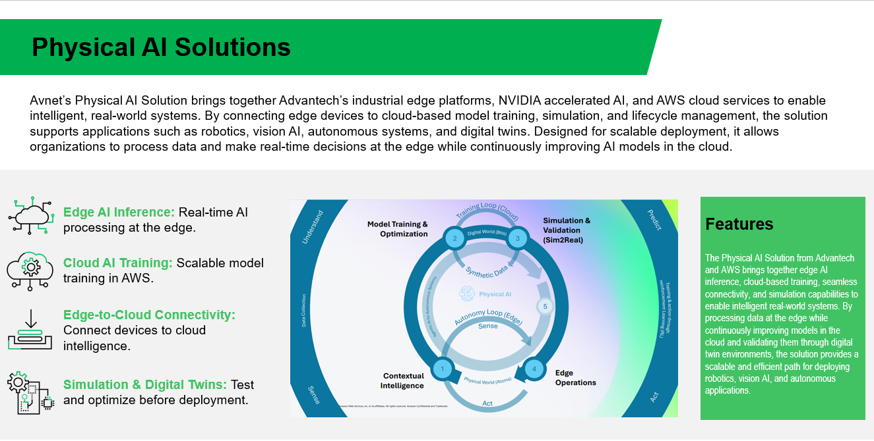
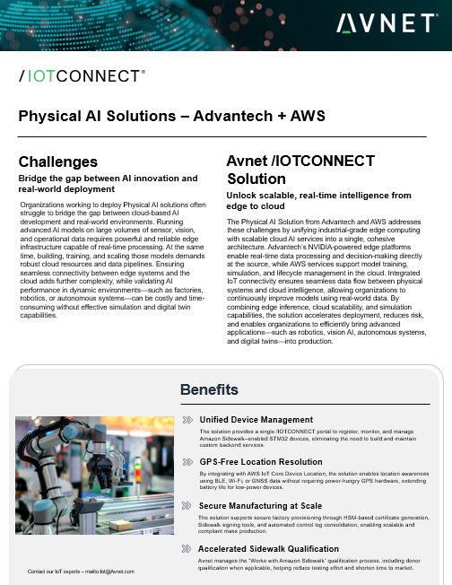
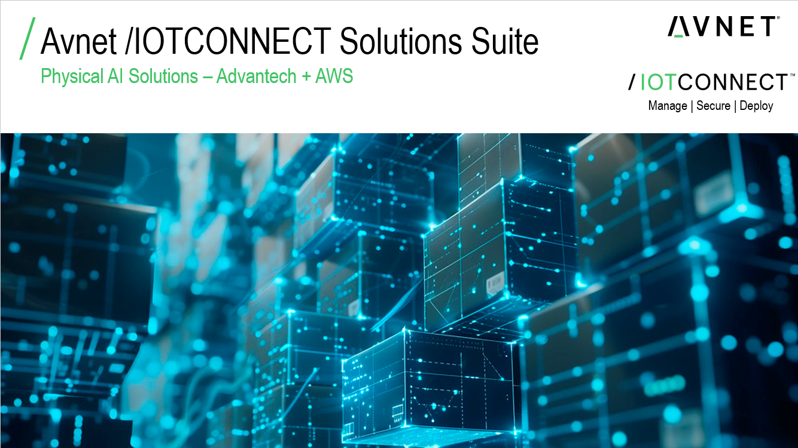

Avnet & AWS Data Center Automation
Marketplace Index & Solution Accelerator
Solution Brief
First Call Deck
Marketplace Listing
Learn more
Add MP link and update FCD & Solution brief image
DIFFERENTIATORS
Related AWS Products & Services Avnet has an all-in-one offering of products and IoT services. Our offering ranges from Components, HW and Embedded SW design, and Secure cloud connectivity. In addition, our IoT services include /IOTCONNECT SaaS, powered by AWS, cloud side development including web and mobile Apps, Visualization services, UI/UX, AI, ML capabilities, DevOps, and more. Avnet as a partner enables the customer to scale their design as far as is needed. Unlike other traditional hardware or ISV partners, /IOTCONNECT enables a full rich ecosystem from edge to cloud for ease of device onboarding and security. Other platform providers, on the other hand, do not offer the capability to complete the entire supply chain needed for a customer to go to mass production. Avnet’s /IOTCONNECT offers the fundamental building blocks any secure, robust, managed cloud platform would need. Key advantages include flexibility to be adapted to any IoT use case, easy integration with other IoT systems, external data sources and enterprise software.
KEY LINKS
View Salesforce Record here View Avnet’s AWS microsite here View Softweb Solutions (an Avnet company) microsite here View Avnet’s Marketplace offerings here
DEPLOYMENT DETAILS
/IOTCONNECT deployed as SaaS on AWS with monthly billing. Avnet’s offering of electronic and related components and IoT/AWS-enabled devices including AWS ExpressLink can be purchased separately. Services such as hardware & software design, IoT cloud application and visualization development can be purchased by private offer, or direct from the partner.
NEXT STEPS
Contact PDM: Andrew Howard Contact AM: Jen Dixon Contact SAs: Gaurav Gupta
Avnet Contacts: Global Alliance Lead - GTM: Gavin Kirk Global Dir. Cloud Supplier Alliances – Phil Heine Technical Lead – Vibhu Bhutani IoT BDMs Americas– Chad Dirks IoT BDM Lead EMEA – Ankit Zaveri IoT BDM Lead Avnet APAC – GM Krishna
AWS sellers can contact AWS Contact Andrew Howard, anhowad@amazon.com, Jen Dixon jen.dixon@amazon.com , or Gavin Kirk Gavin.Kirk@avnet.com
AMAZON CONFIDENTIAL | For Internal Use Only

