Slide 1
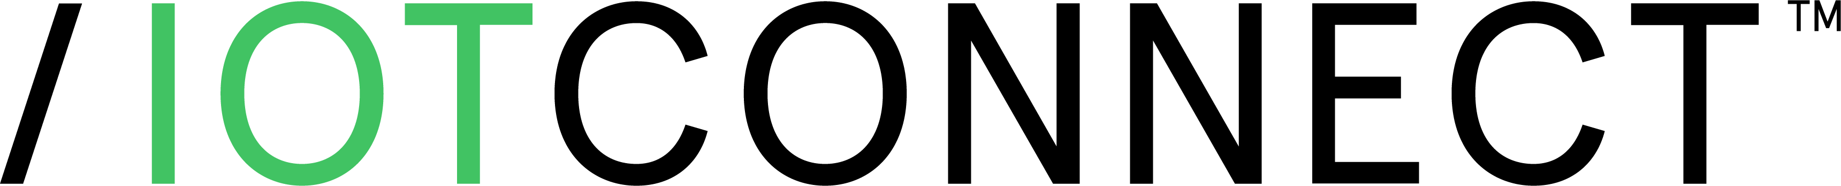

Avnet /IOTCONNECT Solutions Suite
Data Center Operations Automation – Avnet + AWS
Manage | Secure | Deploy

Slide 2

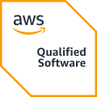
Solution Accelerator & Marketplace Index
SaaS offering
/IOTCONNECT enabled solutions
Smart Generator Monitoring
Smart Warehouse Monitoring
Data Center Operations Automation – Avnet + AWS
Avnet’s Data Center Operations Automation solution, built with Softweb Solutions and AWS, unifies real-time telemetry, predictive maintenance, and digital-twin visualization for data center operators. Running on /IOTCONNECT with AWS IoT Core, Greengrass, Bedrock, and SageMaker, it converts raw sensor data into predictive alerts, live dashboards, and automated control loops—helping operators move from manual rounds to automated operations.
Smart City Noise Detection
AWS IoT Greengrass
Smart Asset Monitoring
Data Center Automation
Smart Facility Solutions
STM32 Amazon Sidewalk
Smart Factory Solutions
Security CRA
Smart Fleet Management

Slide 3
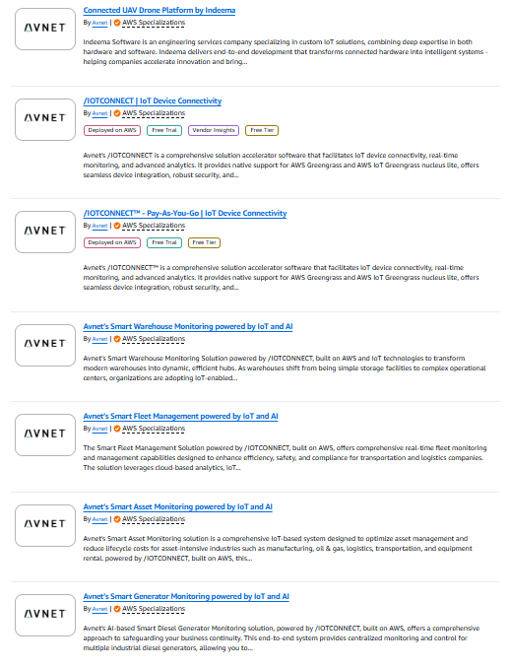
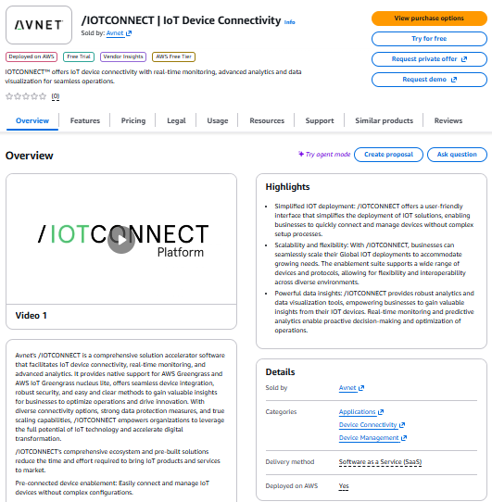
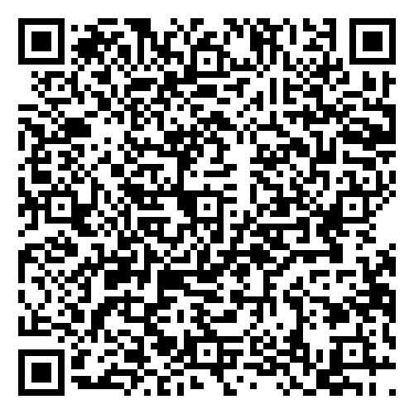
Visit Our Marketplace Listings
All Avnet Listings

Slide 4

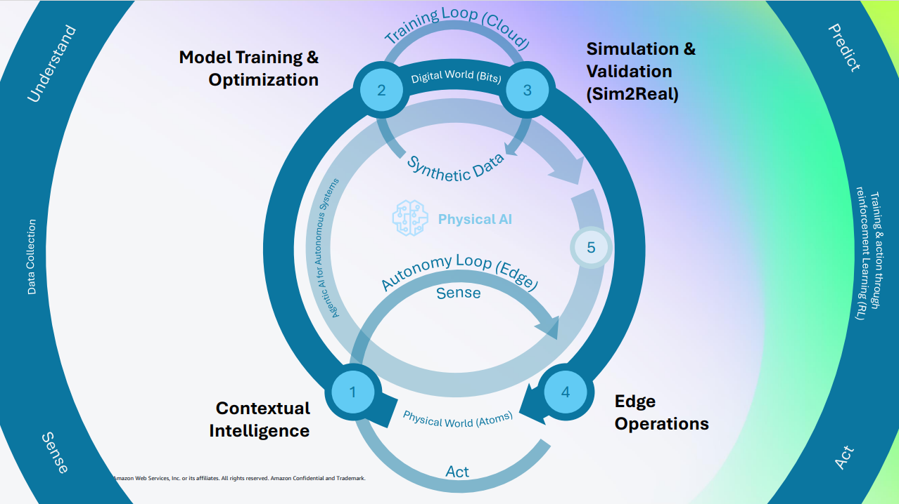
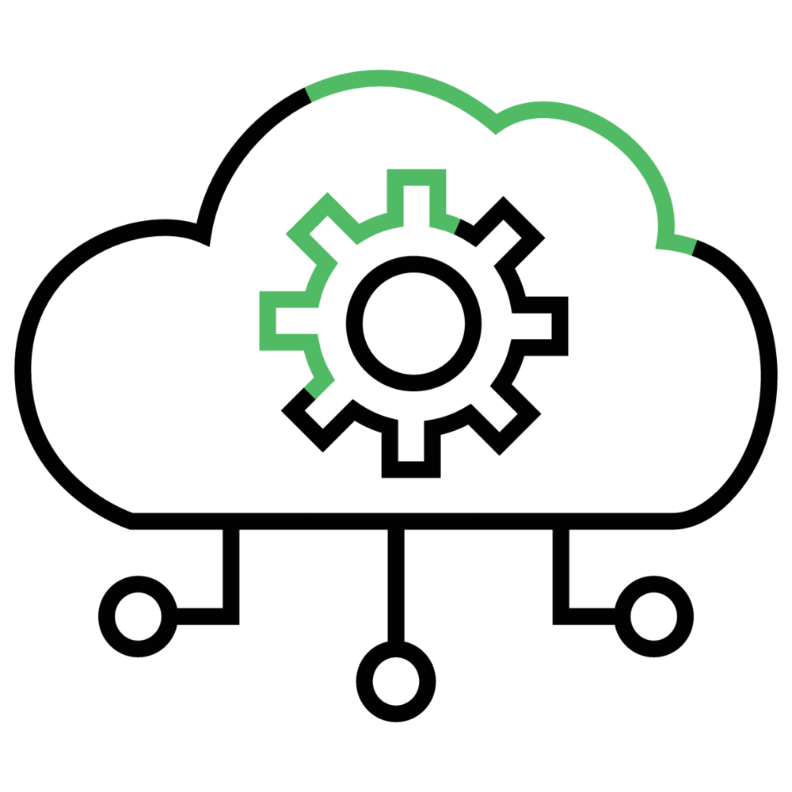

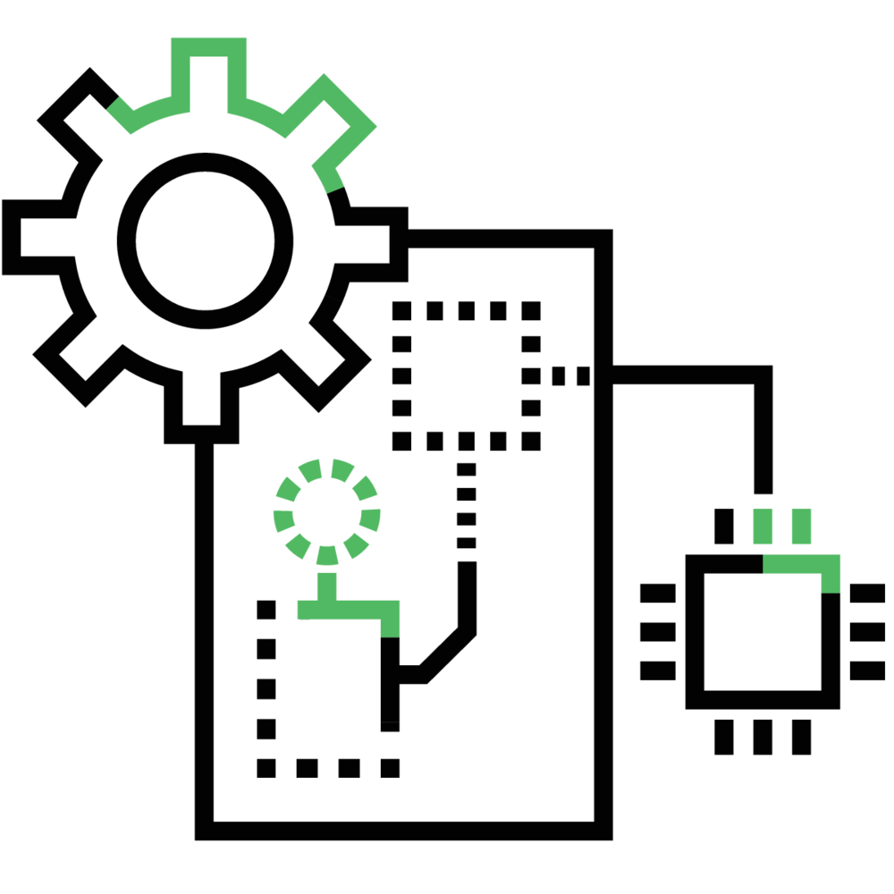
Data Center Operations Automation
Avnet’s Data Center Operations Automation solution brings together sensor-driven edge intelligence, /IOTCONNECT, and AWS cloud services to automate data center operations. By connecting CRAC units, chillers, UPS systems, PDUs, and environmental probes to real-time dashboards, predictive maintenance, and digital-twin visualization, the solution automates four critical domains: thermal and cooling, environment and safety, power and energy, and asset health. Designed for scalable deployment, it supports facilities from a single 10,000 sq ft site to large multi-site portfolios.
Edge AI Inference: On-device vibration and acoustic classification.
Features
Data Center Operations Automation from Avnet and AWS brings together edge AI inference, cloud-based analytics, seamless connectivity, and digital-twin visualization to automate facility operations. By classifying failure signatures on-device while computing PUE, compliance, and capacity insights in the cloud, the solution provides a scalable and efficient path from manual walkthroughs to predictive, audit-ready operations.
Cloud AI & GenAI: Bedrock runbooks, SageMaker models.
Edge-to-Cloud Connectivity: Greengrass to /IOTCONNECT on AWS.
Simulation & Digital Twins: 2D/3D twins with live telemetry overlays.
Learn more
Marketplace Listing

Slide 5
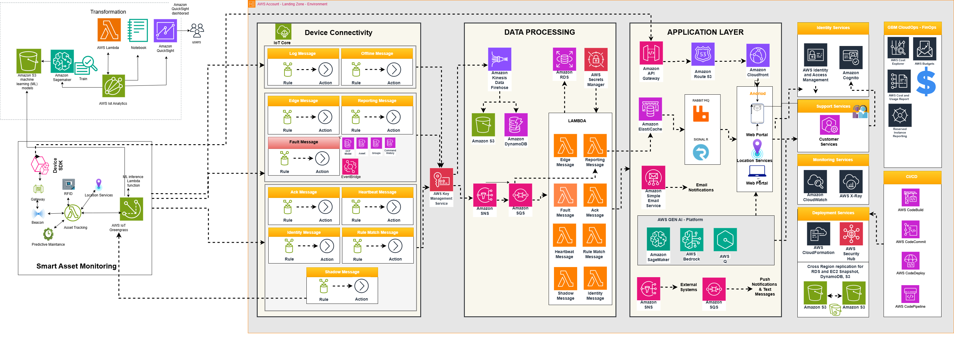
Solution Architecture – Data Center Operations Automation

Slide 6
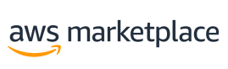

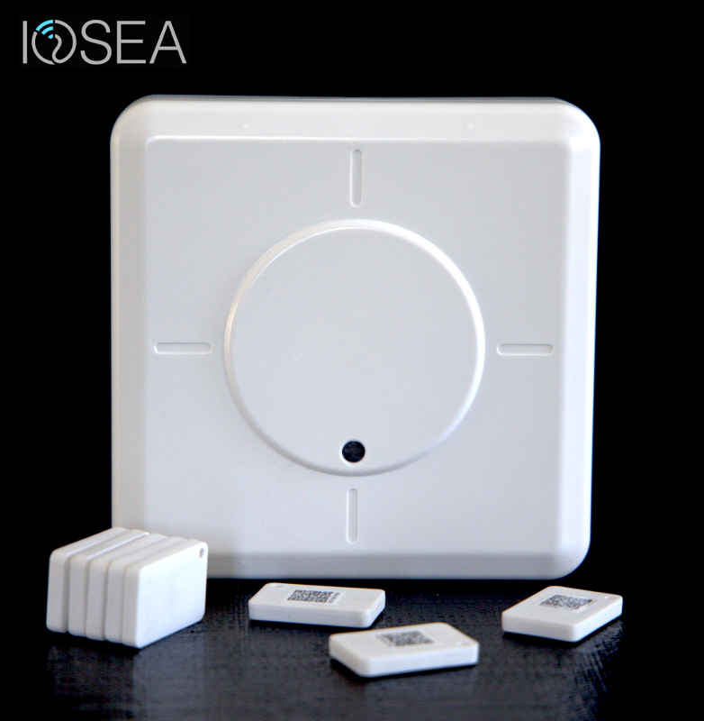
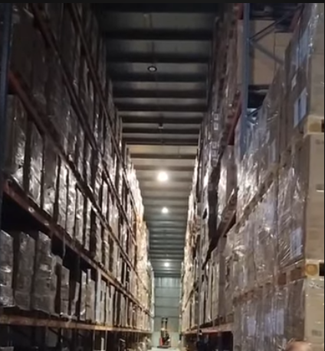
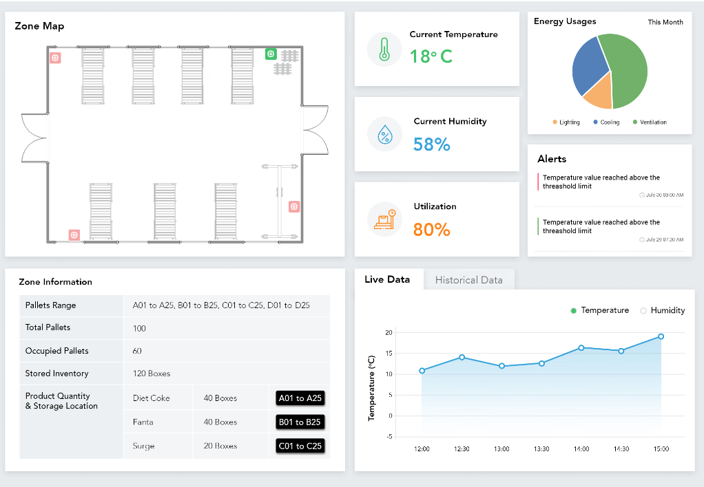

Smart Warehouse, Asset & Worker Tracking
IOSEA — Indoor Location Technology | Multi-Partner Solution
Challenge
Businesses require exact indoor location tracking where aGPS fails — inside warehouses, cruise ships, mines, and cross-dock facilities. Manual asset management and worker tracking cannot provide real-time visibility at scale, leading to operational inefficiencies and safety gaps.
Solution
IOSEA's hardware asset tracking sensor uses advanced electromagnetic and signal processing algorithms for high-accuracy indoor positioning. Connected via Avnet IOTCONNECT with multi-partner engagement (IOSEA, Avnet, Nordic, Renesas, Panasonic, Silicon Labs, Ublox). Supports beacons & tags, networking devices, and smartphone/wearable integrations for comprehensive facility intelligence.
Key Results
Data science & IoT-enabled asset and people monitoring
Monitor all major assets within a facility for operational efficiency
Customized experience with Avnet's Acceleration Frameworks
Target: 120,000 connected devices across 12 customer wins
Expected ARR: $255,050
Use Cases: Cruise lines, warehouse/cross-dock, mines — dead-reckoning location where aGPS fails
Softweb Solutions | An Avnet Company | AWS Premier Partner

Slide 7

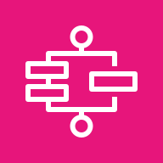
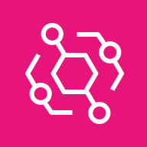

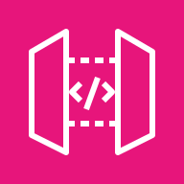
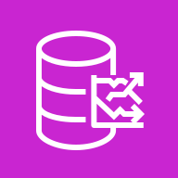


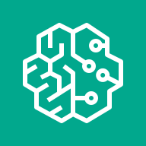
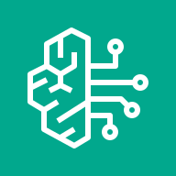
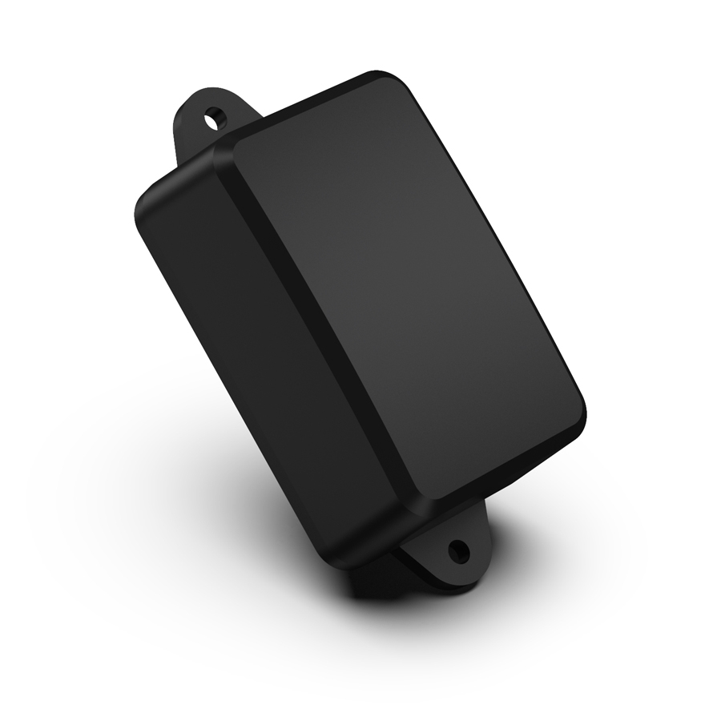
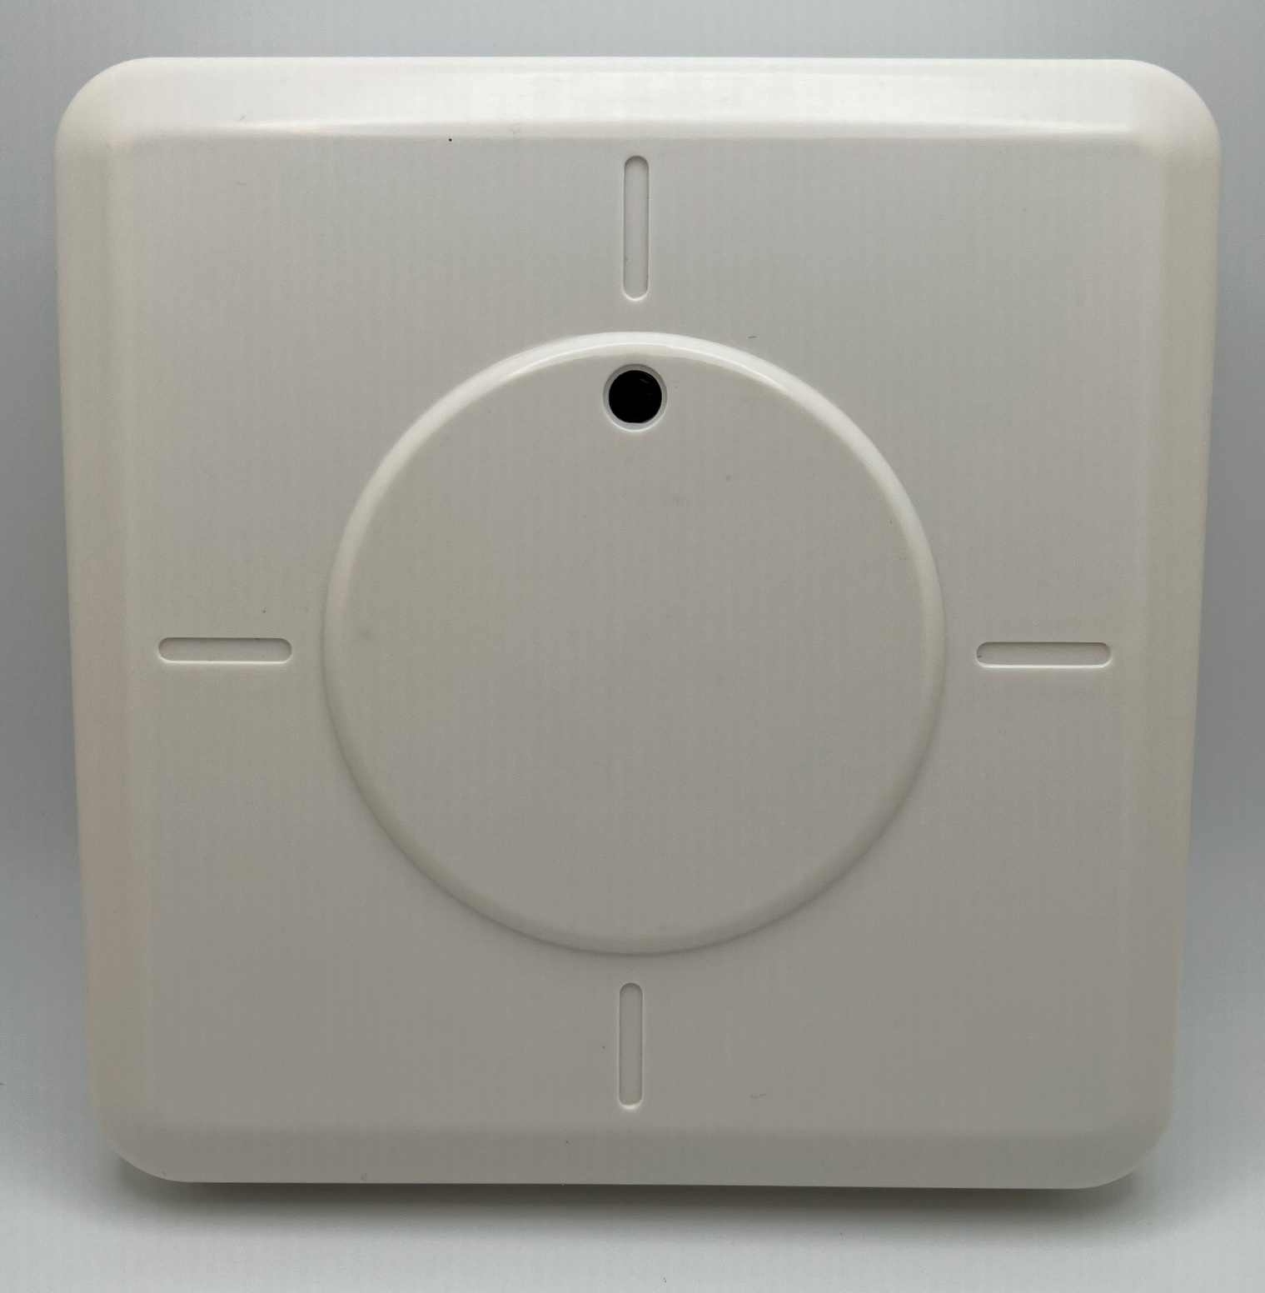
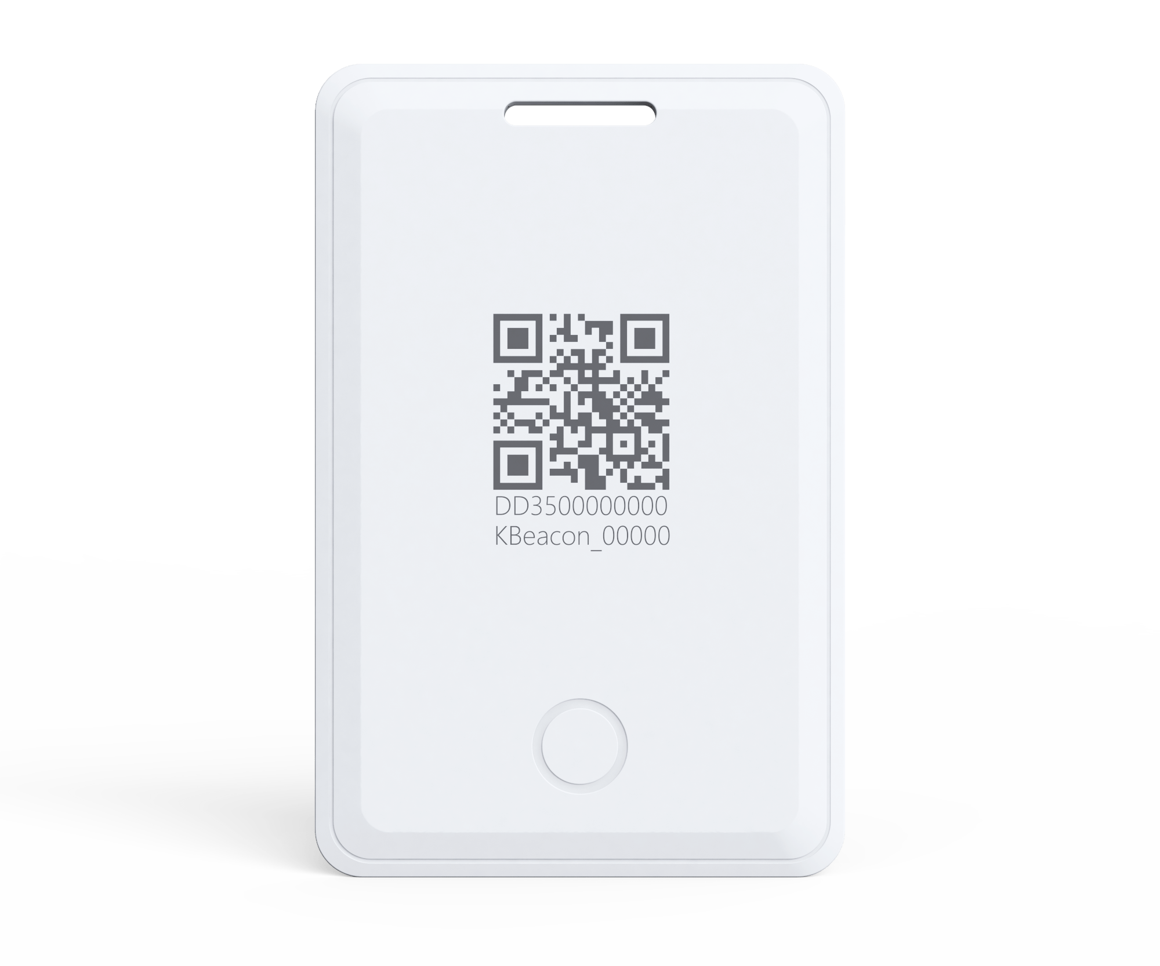
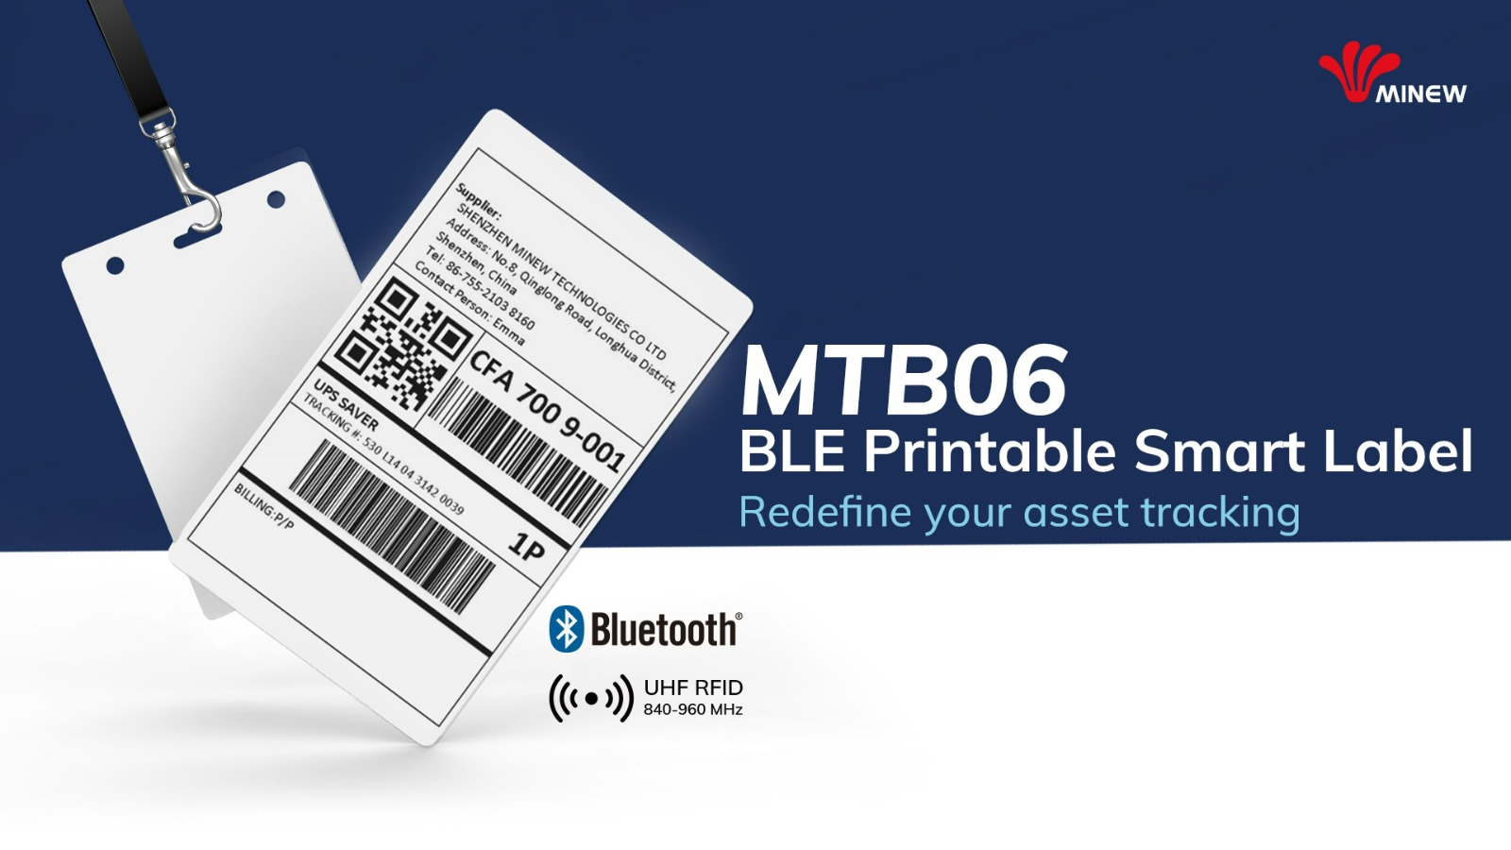
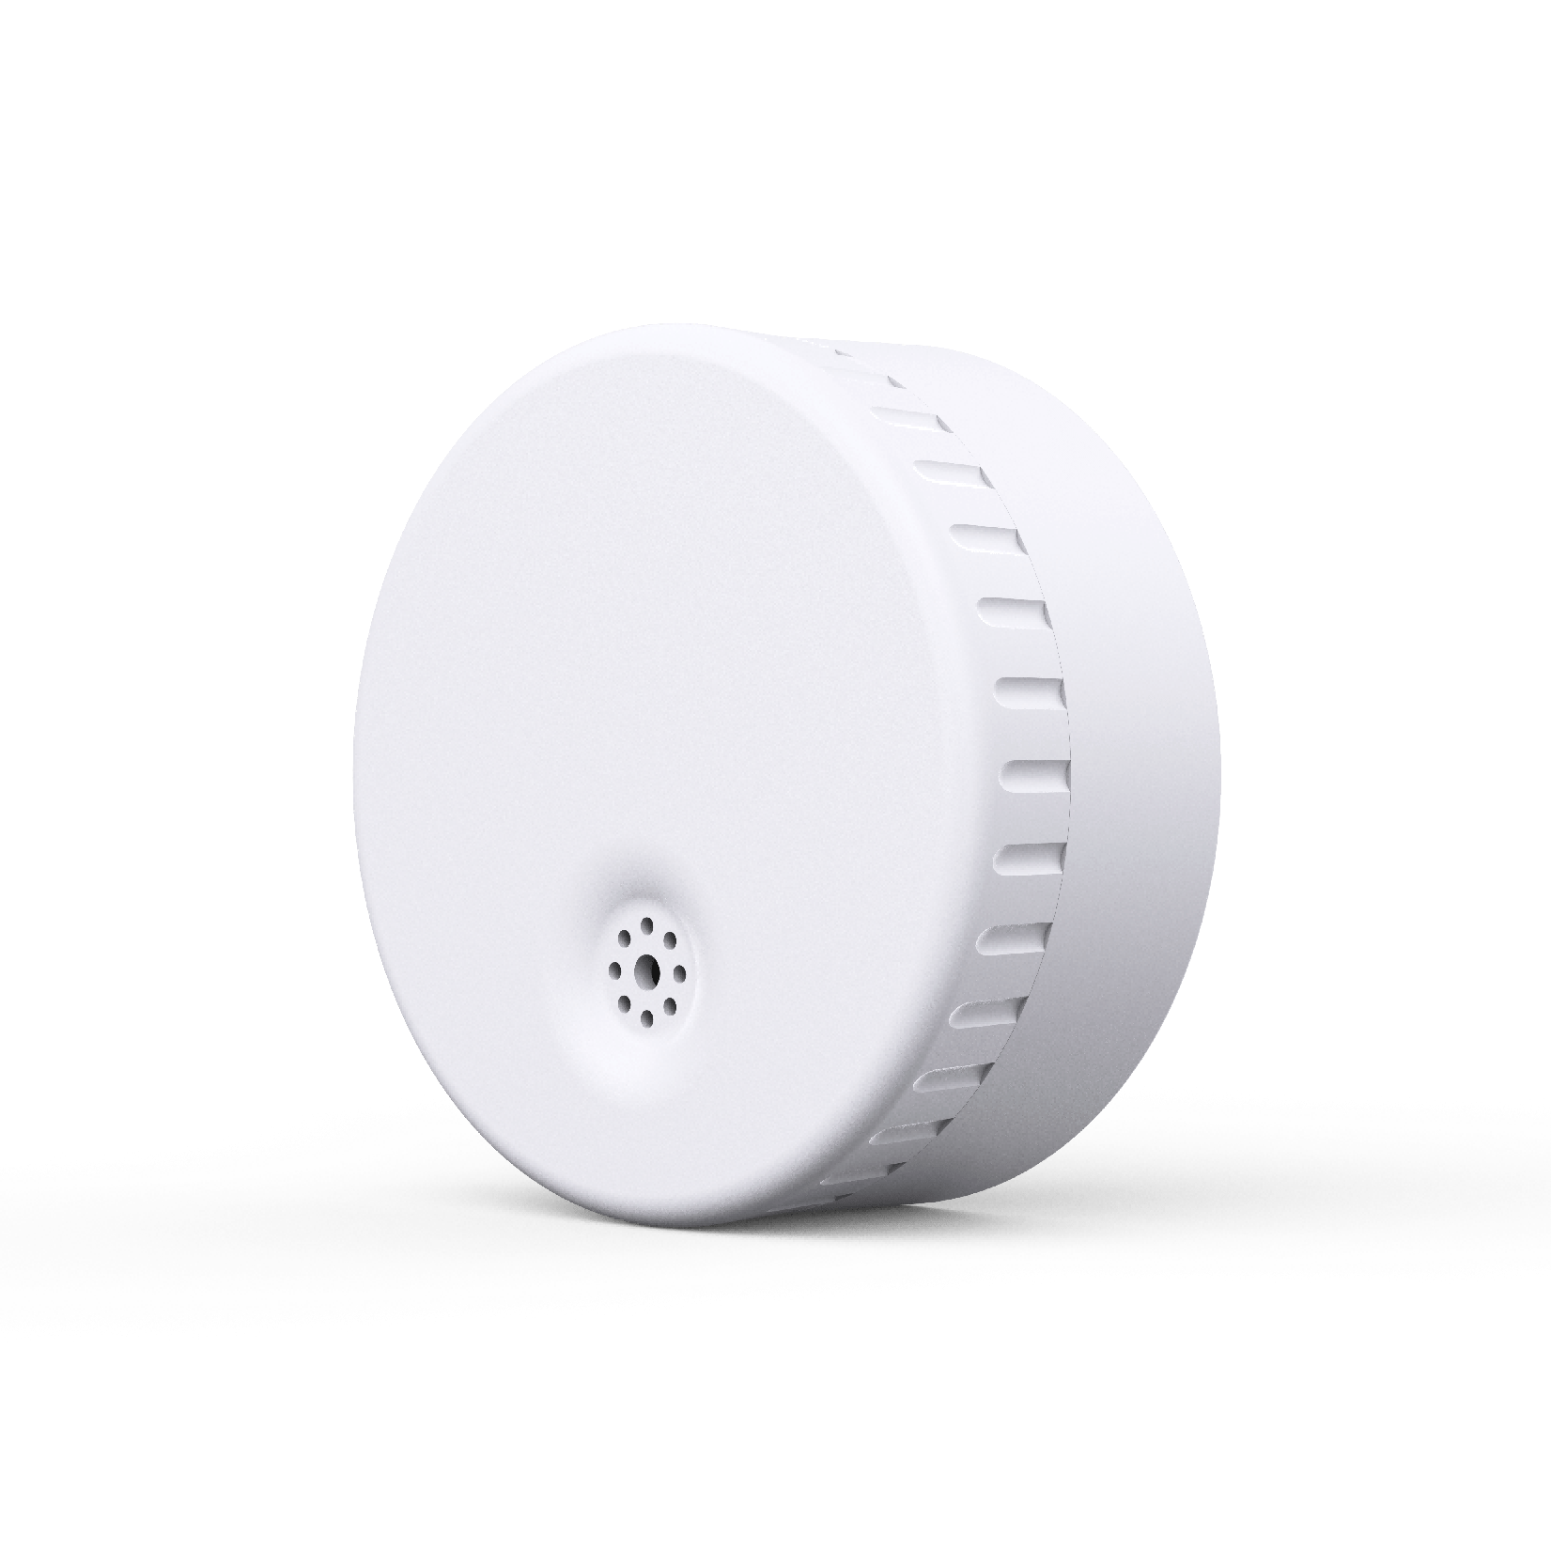

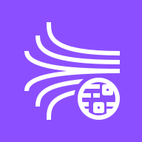





Smart Warehouse — Asset & Worker Tracking
AWS Architecture | Business Outcome Xcellerator
CUSTOMER
IOSEA Indoor Location
Multi-partner: IOSEA · Avnet + silicon
SCALE
120K devices
12 customer wins
PIPELINE
$255K ARR target
Warehouse · cross-dock · cruise · mines
SILICON
5-vendor BLE stack
Nordic · Renesas · Panasonic · SiLabs · Ublox
EDGE / ON-PREMISE
/IOTCONNECT
AWS CLOUD | Customer Solution AWS Services
IOSEA ArgusOne
Locator · BLE mesh
MTB06 / Molex
Printable BLE tags
Ingestion + Management Plane
COMPUTE & EVENTS
Lambda · triangulation + geofence
Step Functions · alert flow
SNS · worker safety
EventBridge
Device Mgmt + Templates
Container / Fork
IP67 · KanBan moves
Cold Chain Tag
Temp · humidity · IP67
120K devices · 12 sites · multi-tenant
Cert Lifecycle + KeyScaler
APIS & DATA
X.509 auto-rotate · PKI integration
API GW · IOSEA portal
Timestream · location TS
DynamoDB · asset registry
S3 · event archive
Industrial IoT Gateway
Customer HW · Linux
OTA Firmware
HW + SW version separation
AI / ML
/IOTCONNECT SDK · BLE mesh aggregation · dead-reckoning where aGPS fails
Device Twin + Commands
SageMaker · occupancy + worker safety ML
Bedrock · facility GenAI insights
BLE config · geofence policy
PROTOCOLS BLE 5.x (beacon + mesh) · MQTT/TLS · HTTPS
BUILT ON AWS
APPS · IDENTITY · AUDIT
Location · facility map
QuickSight · live zones
Cognito · worker SSO
KMS + CloudTrail
IoT Core
Kinesis
Defender
1 Tags emit BLE · Locator scans RSSI 2 Gateway → /IOTCONNECT 3 IoT Core → Kinesis → Lambda 4 Timestream + Location Service 5 ML anomaly → SNS safety alerts 6 QuickSight + IOSEA portal
AVNET
DELIVERY
SCOPE
HARDWARE
FIRMWARE
INSTALL
ISV
MANAGED
ArgusOne + BLE tags, multi-vendor silicon
/IOTCONNECT SDK, BLE stacks
Site survey, locator placement
IOSEA engine + Avnet Acceleration Framework
Device ops · cert rotation · ML retrain
Softweb Solutions | An Avnet Company | AWS Premier Partner
3 / 11
Notes:
SELL MOTION Avnet leads silicon → firmware → install → ISV → AWS → ops. AWS seller co-sells IoT Core + Kinesis + SageMaker consumption on the Acceleration Framework.

Slide 8
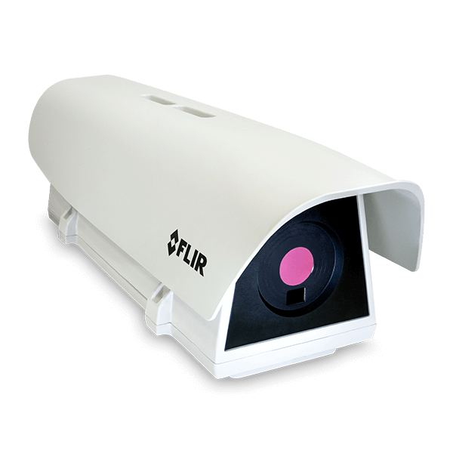
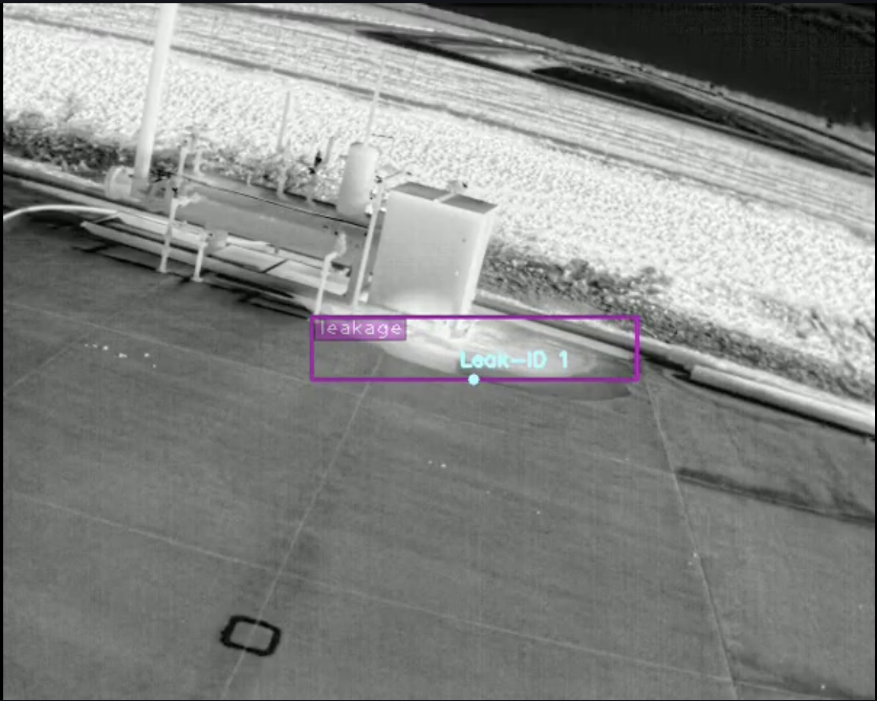
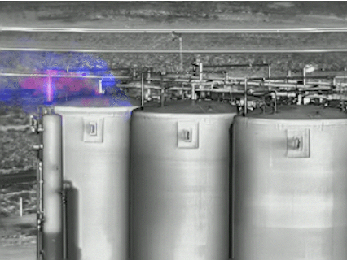
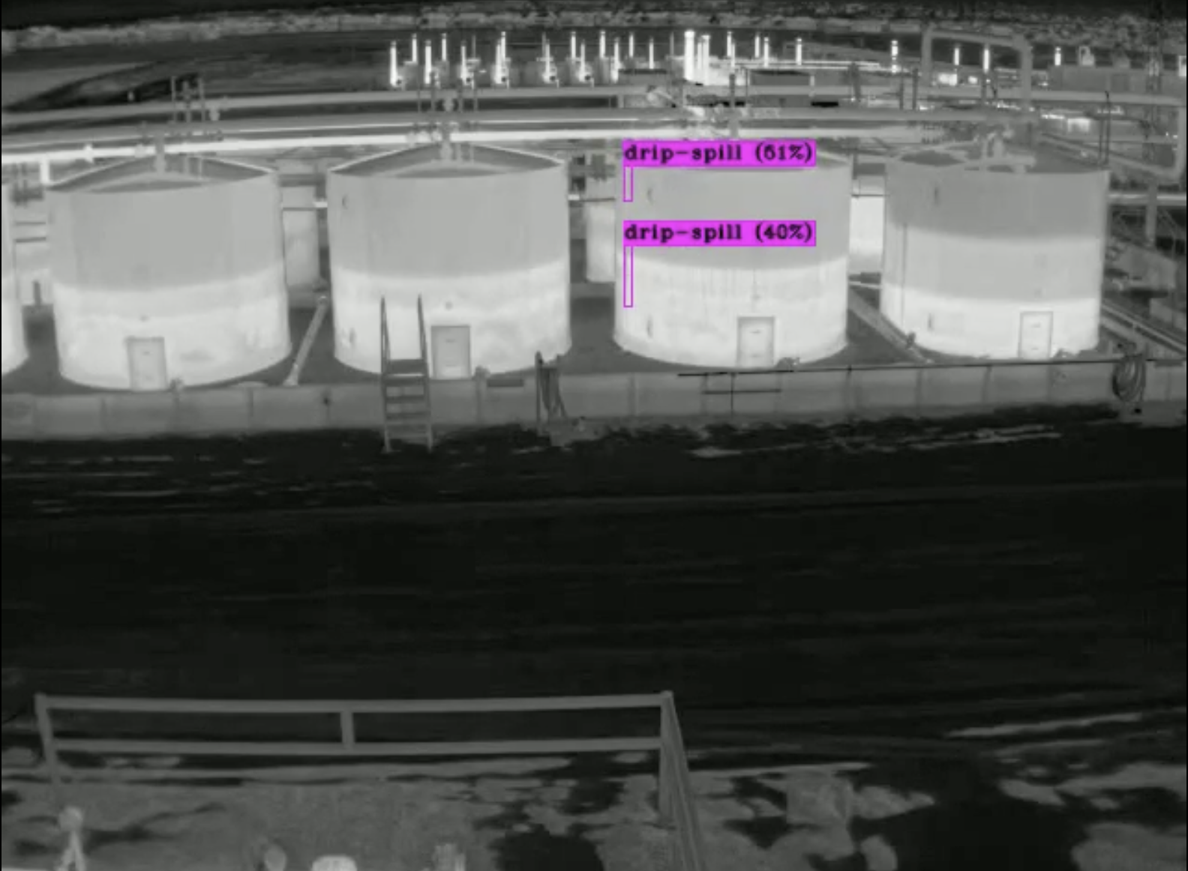

Fluid / Leak Detection
Energy Sector
Challenge
Required automated detection of liquid pooling and leakage at industrial facilities using thermal and RGB camera feeds. Manual rounds missed intermittent events and couldn't provide 24/7 coverage.
Solution
Image segmentation model distinguishes liquid textures, color, and reflectivity from normal surfaces. Anomaly detection learns normal baseline conditions and flags deviations like pooling liquids. Deployed on thermal cameras for 24/7 leak monitoring with bounding box + Leak-ID tracking.
Video Link
Video Link
Key Results
Real-time leak identification with Leak-ID
Thermal + RGB camera fusion
Anomaly-based detection (no labeled data needed)
Automated alert pipeline for containment
DC Application: Coolant leak detection, water ingress near racks, HVAC condensation, raised floor flooding
AVI Video Link
MOV Video Link
Softweb Solutions | An Avnet Company | AWS Premier Partner

Slide 9
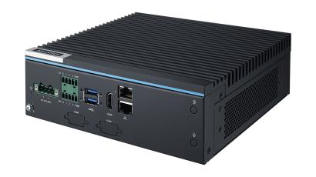
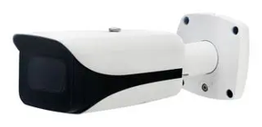



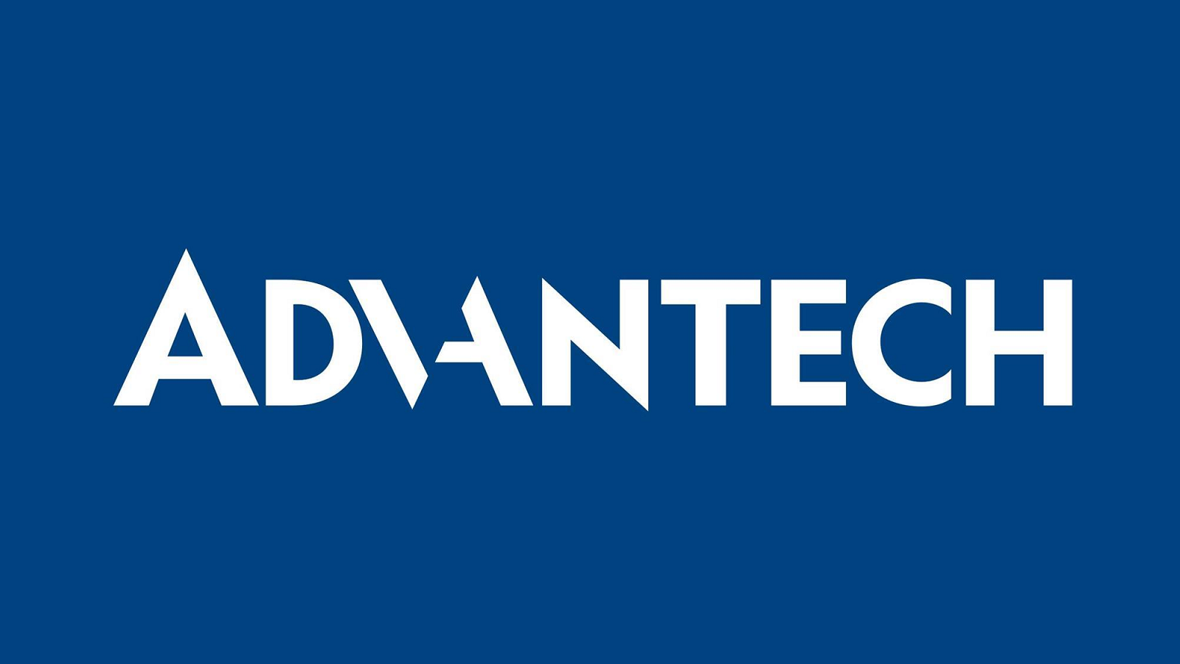
Fluid / Leak Detection — Thermal + RGB Vision at Edge
AWS Architecture | Deployed Solution
CUSTOMER
Energy & Industrial
Energy sector
COVERAGE
24/7 leak ID
Thermal + RGB fusion · Leak-ID tracker
DC APP
Coolant · HVAC
Water ingress · raised-floor flooding
MODELS
Seg + anomaly
No labeled data needed · learn baseline
EDGE / ON-PREMISE
/IOTCONNECT
AWS CLOUD | Customer Solution AWS Services
FLIR Thermal
Fixed industrial camera
RGB Camera
ONVIF-compliant
Ingestion + Management Plane
COMPUTE & EVENTS
Lambda · alert pipeline
Step Functions · containment
SNS + SES alerts
EventBridge
Device Management
NVIDIA Jetson Edge
Camera + Jetson fleet
APIS & DATA
Greengrass v2 · GStreamer
Cert Lifecycle + KeyScaler
API GW · ops console
DynamoDB · Leak-IDs
Timestream · events
S3 · video + training
Image segmentation · anomaly detection · Leak-ID tracker (local inference, no cloud dependency)
X.509 auto-rotate · PKI
OTA Firmware + Models
Edge ML model versioning
AI / ML · MLOps
PROTOCOLS RTSP / ONVIF · MQTT/TLS · KVS video producer
Edge Rules + Twin
SageMaker Pipelines · auto-retrain on drift
Bedrock · GenAI incident summary
Leak-ID thresholds per site
BUILT ON AWS
APPS · IDENTITY · AUDIT
QuickSight · leaks
CloudWatch · edge
Cognito · ops SSO
KMS + CloudTrail
IoT Core
Greengrass
KVS
Defender
1 Cameras → Jetson (RTSP) 2 Greengrass edge ML → Leak-ID 3 /IOTCONNECT → IoT Core + KVS 4 Lambda + Step Functions alert 5 Bedrock incident summary 6 Drift → SageMaker retrain loop
AVNET
DELIVERY
SCOPE
HARDWARE
FIRMWARE
INSTALL
ISV
MANAGED
FLIR thermal + RGB cameras, NVIDIA Jetson
Greengrass + edge ML, GStreamer pipeline
Camera placement, thermal calibration
CleanConnect.ai detection + ops console
Model retraining, drift monitoring, ops
Softweb Solutions | An Avnet Company | AWS Premier Partner
4 / 11
Notes:
SELL MOTION Avnet owns cameras → Jetson → edge ML → cloud ops. AWS seller co-sells Greengrass + KVS + SageMaker + Bedrock consumption.

Slide 10
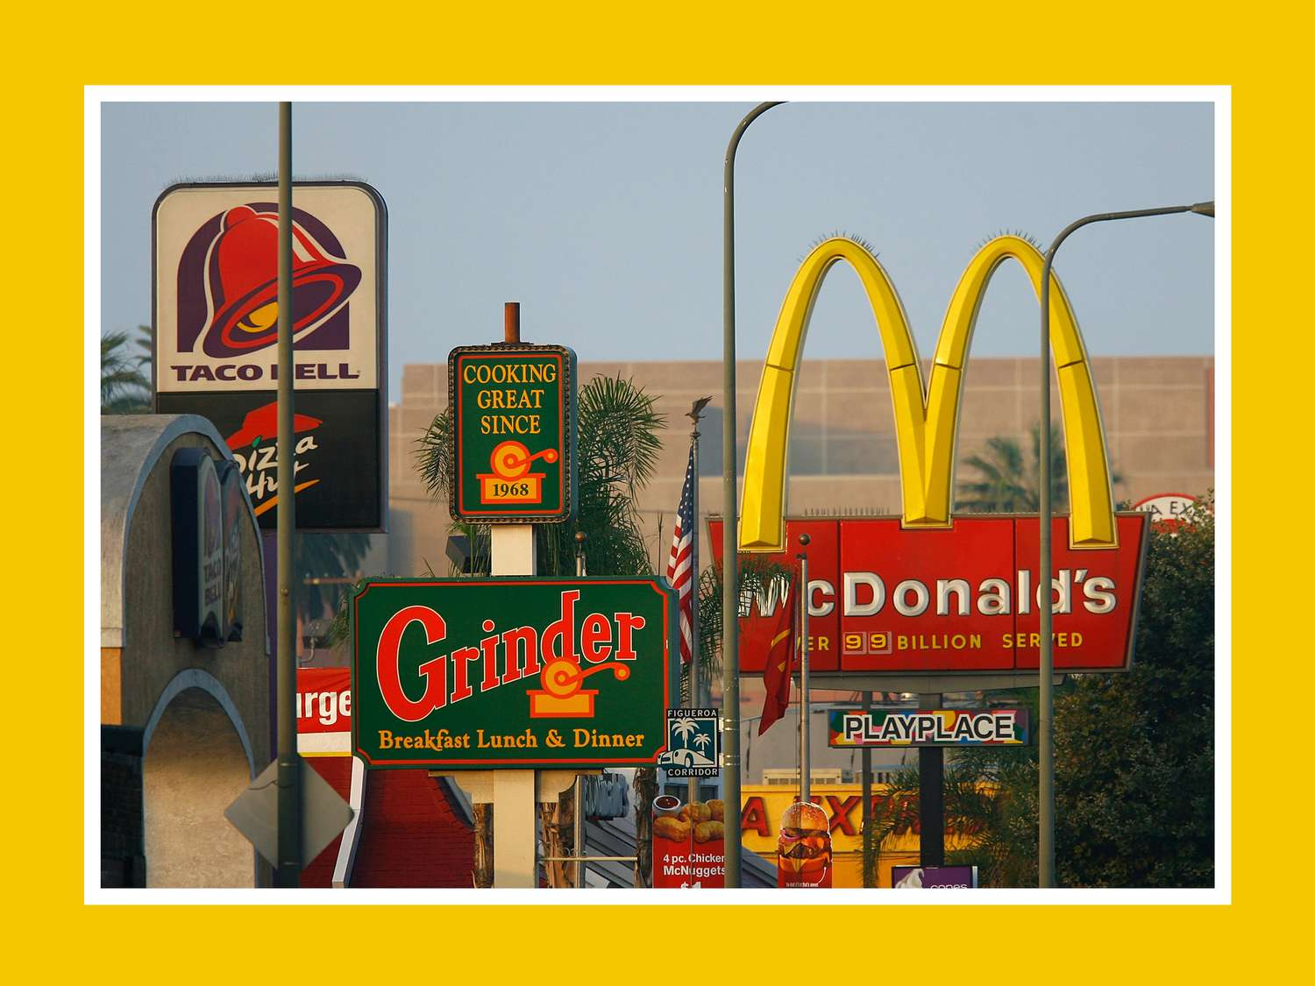
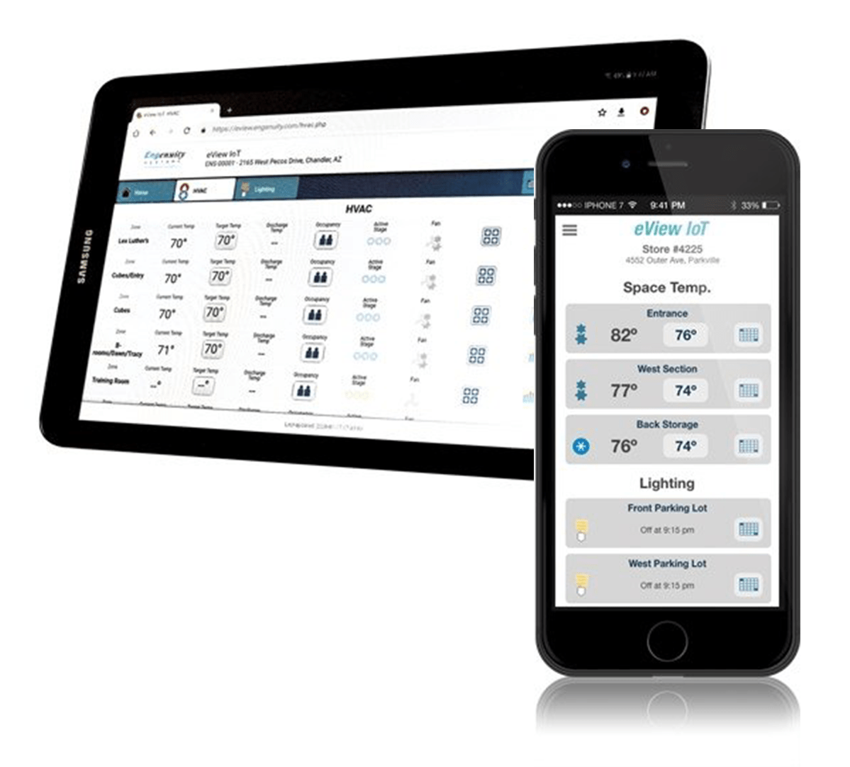
Energy Management Solution
Engenuity Systems — Building Automation & Smart Energy
Challenge
QSR chains, retail, and corporate facilities needed optimized energy management across thousands of locations. Existing systems lacked AI/ML capabilities for predictive maintenance and couldn't integrate diverse building hardware — meters, HVAC controllers, sensors, actuators, thermostats, and refrigeration units.
Solution
Engenuity's eViewIoT platform on Avnet IOTCONNECT delivers end-to-end building energy monitoring. Incorporates energy and flow meters, lighting and HVAC controllers, a wide array of sensors and actuators, and application-specific controllers. AI/ML capabilities provide demonstrable value with predictive maintenance and energy optimization across hundreds of supported Building & Energy OEMs.
Key Results
Optimized budget while increasing profitability
Stay ahead of maintenance with energy-saving measures
Hundreds of Building & Energy OEMs supported
Wells Fargo: New opportunity across 3,500+ facilities
Customers: Burger King, Wendy's, McDonalds, Five Below | Partners: Engenuity, Avnet, Axsys Automation
Softweb Solutions | An Avnet Company | AWS Premier Partner

Slide 11
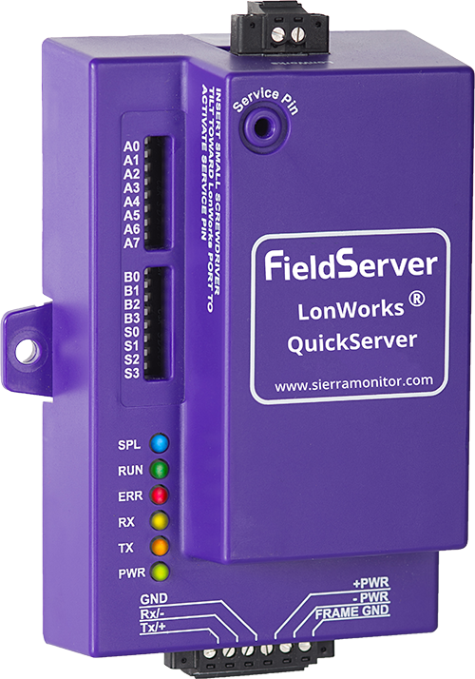
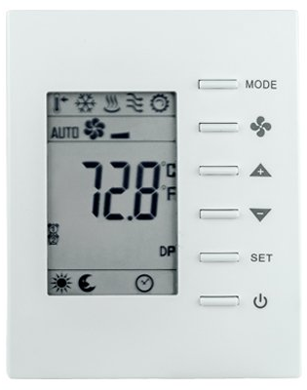
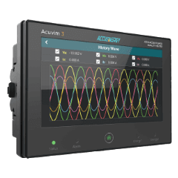

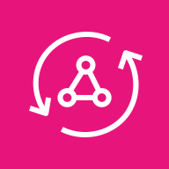
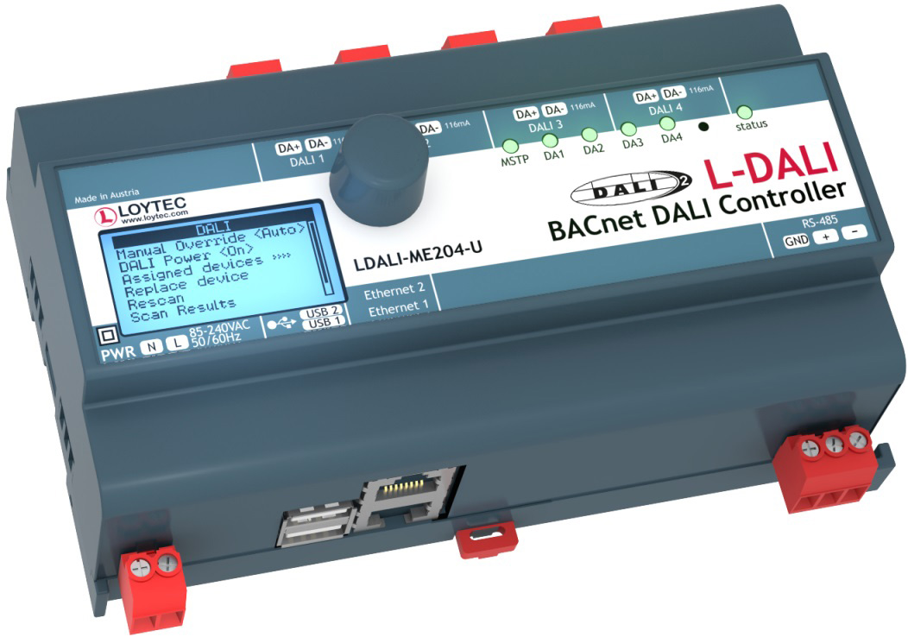
Energy Management — Building Automation + Smart Energy
AWS Architecture | Business Outcome Xcellerator
CUSTOMER
Engenuity eViewIoT
Partners: Engenuity · Avnet · Axsys
SCALE
3,500+ facilities
Wells Fargo 600+ opportunity
QSR ANCHORS
Burger King · Wendy's
McDonald's · Five Below
OEM REACH
Hundreds of B&E OEMs
multi-tenant by site / brand / region
EDGE / ON-PREMISE
/IOTCONNECT
AWS CLOUD | Customer Solution AWS Services
Energy + Flow Meters
Modbus RTU / TCP · pulse
HVAC Controllers
BACnet IP / MSTP
Ingestion + Multi-Tenant Management
COMPUTE & EVENTS
Lambda · demand response
Step Functions · workflows
EventBridge · DR events
SNS · maintenance
Multi-tenant Hierarchy
Lighting + Thermostat
0-10V / DALI / Zigbee
Refrigeration
Modbus / BACnet
3,500+ sites · brand / region
Cert Lifecycle + KeyScaler
APIS & DATA
API GW · eViewIoT
Timestream · energy TS
DynamoDB · sites
S3 · historical + bills
Building Edge Gateway
Bulk provision · auto-rotate
Greengrass v2 · per-site
OTA Firmware
Gateway + controller FW
AI / ML
Protocol translators · BACnet · Modbus · MQTT · local rules + offline store
Protocol Adapters
SageMaker · predictive maintenance + optimization
Bedrock · GenAI savings insights
BACnet / Modbus normalization
PROTOCOLS BACnet IP/MSTP · Modbus RTU/TCP · MQTT/TLS · Zigbee
BUILT ON AWS
APPS · IDENTITY · AUDIT
QuickSight · portfolio
AppSync · portal
Cognito · tenant SSO
KMS + CloudTrail
IoT Core
Greengrass
SiteWise
Kinesis
1 Equipment → Gateway (BACnet / Modbus) 2 Greengrass → /IOTCONNECT MQTT 3 IoT Core → SiteWise + Kinesis 4 SageMaker predictive maintenance 5 Bedrock savings insights 6 eViewIoT portfolio dashboards
AVNET
DELIVERY
SCOPE
HARDWARE
FIRMWARE
INSTALL
ISV
MANAGED
Meters, controllers, sensors — multi-OEM
Greengrass + protocol translators
Site rollout · OEM integration (Axsys)
Engenuity eViewIoT on /IOTCONNECT
Multi-tenant ops · savings optimization
Softweb Solutions | An Avnet Company | AWS Premier Partner
5 / 11
Notes:
SELL MOTION Avnet scales eViewIoT from QSR pilots to 3,500+ facilities. AWS seller co-sells IoT Core + SiteWise + SageMaker + Bedrock across multi-tenant brand portfolios.

Slide 12
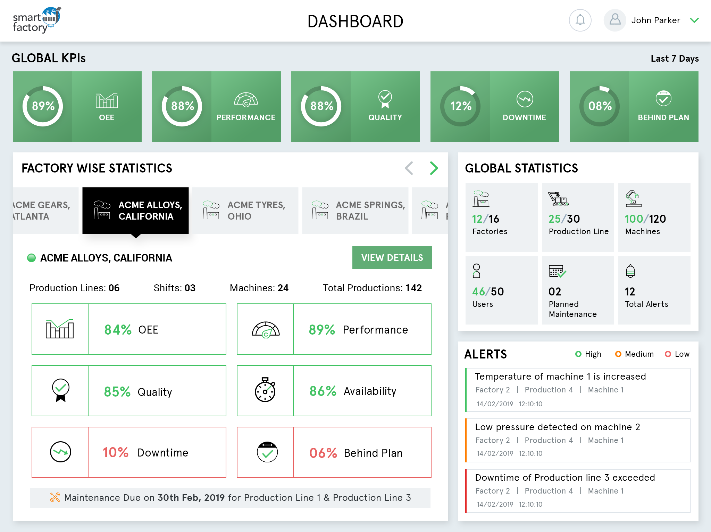
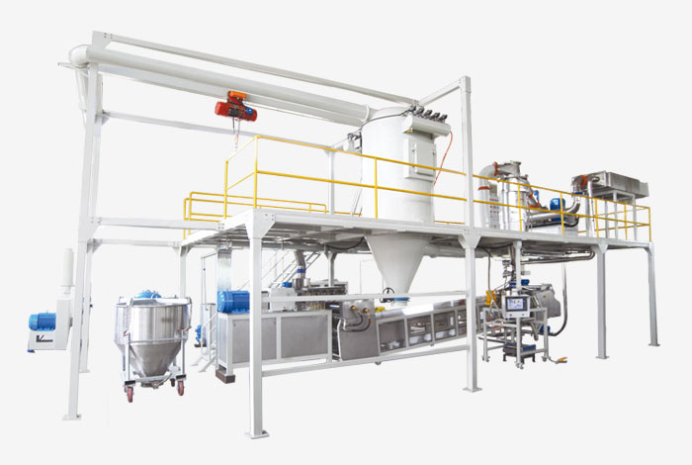
Smart Factory Solution
Leading Powder Coating Manufacturer — Production Intelligence
Challenge
A world-class powder coating manufacturer — the largest privately owned in the U.S. — needed centralized monitoring of production lines across two state-of-the-art facilities. Manual processes couldn't provide real-time visibility into production efficiency, anomaly detection, or predictive maintenance at scale.
Solution
Avnet's Smart Factory solution connected multiple production lines and machines to a centralized dashboard. Enabled data acquisition at different stages of production with remote monitoring, analytics, anomaly detection, and predictive maintenance. Smart rules engine enables autonomous actions based on real-time sensor data and ML-driven insights.
Key Results
59 assets made connected and smart
Increased throughput by ~23%
Reduced inventory/material holding costs by 11%
$0.97 million in ROI generated by March 2019 (first quarter)
Capabilities: Real-time alerts, ML anomaly detection, usage-based reports, autonomous actions
Softweb Solutions | An Avnet Company | AWS Premier Partner

Slide 13
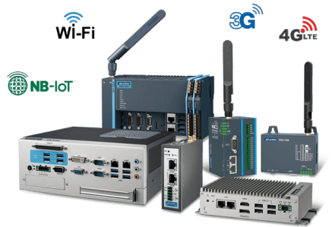
Smart Factory — Production Intelligence
AWS Architecture | Deployed Solution
CUSTOMER
Powder Coating Leader
Largest privately-owned in US
SCALE
59 connected assets
2 state-of-the-art facilities
OUTCOMES
+23% throughput
-11% inventory · $0.97M ROI Q1
CAPABILITY
Autonomous actions
Real-time alerts · ML anomaly · reports
EDGE / ON-PREMISE
/IOTCONNECT
AWS CLOUD | Customer Solution AWS Services
PLCs (lines)
OPC-UA / Modbus
Vibration Sensors
Motor health
Ingestion + Management Plane
COMPUTE & EVENTS
Lambda · autonomous actions
Step Functions · maintenance
EventBridge · alerts
SNS · ops alerts
Fleet Mgmt
Vision Cameras
QC + defect detect
Temp / Pressure
Process sensors
59 assets · 2 facilities
Cert Lifecycle + KeyScaler
APIS & DATA
API GW · CMMS / ERP
Timestream · production TS
DynamoDB · asset log
Industrial Edge Gateway
X.509 auto-rotate · PKI
S3 · reports
Greengrass v2 · DIN-rail
OTA Firmware
Gateway + PLC program updates
AI / ML
OPC-UA client · local edge ML · smart rules engine · autonomous action dispatch
Rules + Device Twin
SageMaker · anomaly + predictive maintenance
Bedrock · GenAI shift reports
Threshold + autonomous dispatch
PROTOCOLS OPC-UA · Modbus · MQTT/TLS · EtherNet/IP
BUILT ON AWS
APPS · IDENTITY · AUDIT
QuickSight · OEE
CloudWatch · ops
Cognito · operator
KMS + CloudTrail
IoT Core
Greengrass
SiteWise
Kinesis
1 PLCs + sensors → Gateway (OPC-UA) 2 Greengrass → /IOTCONNECT MQTT 3 IoT Core → SiteWise + Kinesis 4 ML anomaly → Lambda → EventBridge 5 Step Functions autonomous action 6 QuickSight global OEE dashboards
AVNET
DELIVERY
SCOPE
HARDWARE
FIRMWARE
INSTALL
ISV
MANAGED
Industrial gateways, sensors, vision
Greengrass + OPC-UA + edge ML
Factory-floor integration · 2 facilities
Avnet Smart Factory on /IOTCONNECT
Rules tuning · model retraining · SLA
Softweb Solutions | An Avnet Company | AWS Premier Partner
6 / 11

Slide 14


Pharma Compliance — Smart Factory under 21 CFR Part 11
AWS Architecture | Deployed Solution
CUSTOMER
Leading Global Pharma
Vertically integrated
PLC FLEET
74 PLCs · 5 vendors
Panasonic · Siemens · Mitsubishi · AB · Omron
COMPLIANCE
21 CFR Part 11
Audit · e-sign · data integrity · access
HARDWARE
Dell Edge 3003
Masibus MINT D/A I/O processor
EDGE / ON-PREMISE
/IOTCONNECT
AWS CLOUD
Panasonic / Siemens
Process · S7 / ProfiNET
Mitsubishi / AB
MC · CC-Link · EtherNet/IP
Ingestion + Compliance Management
COMPUTE & EVENTS
Lambda · ML control
Step Functions · batch flow
EventBridge · deviations
SNS · alerts
Device Mgmt (74 PLCs)
Omron PLCs
FINS · EtherCAT
Masibus MINT
D/A I/O processor
5-vendor fleet · GMP hierarchy
Cert Lifecycle + HSM
APIS & DATA
API GW · MES / CMMS / ERP
Timestream · tamper-evident
DynamoDB · recipes / batches
S3 Object Lock · WORM
Dell Edge Gateway 3003
KeyScaler PKI · TPM bind
Greengrass v2 · HSM / TPM
OTA (Signed Firmware)
Change-control audited
AI / ML
Signed firmware · audit logging · store-and-forward for offline compliance
Audited Command Routing
SageMaker · validated model registry
Bedrock · GenAI batch summaries
Every action → CloudTrail
PROTOCOLS S7 / ProfiNET · CC-Link · EtherNet/IP · MQTT/TLS + X.509
BUILT ON AWS
21 CFR PART 11 · AUDIT · IDENTITY
CloudTrail · immutable audit
Cognito MFA · e-sign
KMS · HSM-backed
Secrets Mgr + IAM
IoT Core
Greengrass
SiteWise
Defender
1 PLCs → Masibus MINT → Dell Edge 2 Greengrass → /IOTCONNECT (signed) 3 IoT Core → SiteWise + Timestream 4 Every action → CloudTrail audit 5 Cognito MFA e-sign on release 6 S3 Object Lock WORM batch records
AVNET
DELIVERY
SCOPE
HARDWARE
FIRMWARE
INSTALL
ISV
MANAGED
Dell Edge 3003 · Masibus MINT · 74 PLCs
Greengrass + signed firmware + drivers
GxP-validated rollout · IQ / OQ / PQ
Custom Pharma MES on /IOTCONNECT
21 CFR Part 11 continuous compliance
Softweb Solutions | An Avnet Company | AWS Premier Partner
7 / 11
Notes:
SELL MOTION Avnet delivers 21 CFR Part 11 end-to-end. AWS seller co-sells CloudTrail + KMS + S3 Object Lock + SageMaker — regulated workload with continuous compliance.

Slide 15
Connected AI-Enabled Drone Telemetry
Avnet/Indeema UAV Platform — AWS IoT Core & IOTCONNECT
Challenge
Identifying the right sensors, camera solution & flight controllers in a disparate marketplace. Customers struggle to right size solutions to support agriculture to municipalities.
Solution
Avnet/Indeema drone platform showcases a connected UAV platform streaming telemetry, sensor data, and AI-derived insights into /IOTCONNECT. The solution demonstrates secure connectivity, real-time monitoring, and cloud-based analytics for autonomous systems. Being a platform, customers are able to leverage the functional base drone solution from the platform and customize this off the shelf solution specific to the end customer business use-case at an accelerated scale.
Key Details
Target Hardware: AI-Enabled UAV Platform
Technologies Used: AWS IoT Core, /IOTCONNECT, Indeema UAV Stack
Secure connectivity with real-time monitoring and cloud-based analytics
Customizable off-the-shelf platform for agriculture to municipalities
AWS Marketplace
About the Platform
View Demo
Softweb Solutions | An Avnet Company | AWS Premier Partner

Slide 16

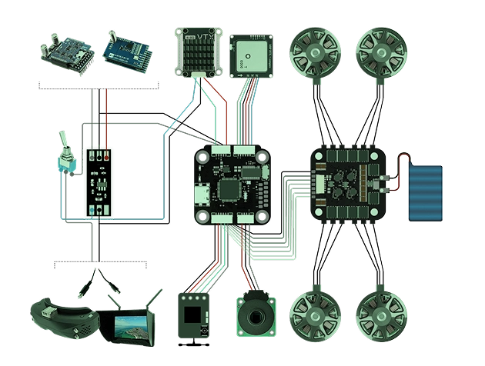
Drone Telemetry — Connected AI-Enabled UAV
AWS Architecture | Business Outcome Xcellerator
CUSTOMER
Avnet / Indeema
AWS Marketplace listing
TARGETS
Ag · municipalities
Infrastructure inspection
EDGE ML
Jetson Orin on-drone
RGB + thermal · object + crop + terrain
STACK
Platform solution
Base + customize per engagement
EDGE · ON-DRONE
/IOTCONNECT
AWS CLOUD | Customer Solution AWS Services
RGB + Thermal
4K gimbal · FLIR radiometric
GNSS + IMU
RTK-GPS · flight controller
Ingestion + Fleet Management
COMPUTE & EVENTS
Lambda · flight events
Step Functions · missions
SNS · incident
EventBridge
UAV Fleet Mgmt
LIDAR / Ultrasonic
Obstacle + altitude
Cellular Modem
4G / 5G (eSIM)
Mobile fleet · per-mission
Cert Lifecycle + KeyScaler
APIS & DATA
API GW + AppSync · mobile
Timestream · telemetry
DynamoDB · flight registry
S3 · imagery + logs
NVIDIA Jetson Orin (on-drone)
Rotating X.509 for mobile
Greengrass v2 · Indeema UAV stack
OTA Models + Firmware
Push to flying fleet
AI / ML
AI on imagery · object + terrain + crop · store-and-forward (LTE outage)
Device Twin + Geofence
SageMaker · train + MLOps
Rekognition · object detect
Bedrock · GenAI mission
Mission params · restricted-zone
PROTOCOLS MQTT / TLS over 4G/5G · KVS producer · WiFi ground-station fallback
BUILT ON AWS
APPS · IDENTITY · AUDIT
Location · geofence
QuickSight · fleet
Cognito · pilot SSO
KMS + CloudTrail
IoT Core
Greengrass
KVS
Kinesis
1 Sensors + cameras → Jetson on drone 2 On-drone ML inference (edge) 3 Cellular → /IOTCONNECT → IoT Core 4 KVS video + Kinesis telemetry 5 Location geofence check 6 Bedrock mission summary
AVNET
DELIVERY
SCOPE
HARDWARE
FIRMWARE
INSTALL
ISV
MANAGED
UAV · Jetson on-drone · RGB + thermal · modem
Greengrass + Indeema flight stack
Field setup · ag + municipalities
Indeema UAV Stack on /IOTCONNECT
Fleet mgmt · mission planning · updates
Softweb Solutions | An Avnet Company | AWS Premier Partner
8 / 11
Notes:
SELL MOTION Avnet ships the connected UAV platform (AWS Marketplace). AWS seller co-sells Greengrass + KVS + SageMaker + Bedrock — customizable for ag / municipalities / inspection.

Slide 17
Summary & Next Steps
Real-Time Intelligence at the Edge: Greengrass and Edge AI classify vibration, acoustic, and thermal signatures on-device for low-latency fault detection.
Scalable AI & GenAI in the Cloud: Analyze telemetry with SageMaker predictive models and Bedrock-powered GenAI runbooks, continuously improving using AWS.
Accelerated Deployment, Staged Journey: Discover, deploy, and decide in 90 days with a four-stage rollout validated at every step before scaling.
Benefits
Benefits
Faster Time to Production: Move from manual rounds to automated operations in weeks with an integrated edge-to-cloud platform.
Improved Operational Efficiency: Reduce human-error incidents ~40% through automated monitoring, escalation, and compliance logging.
Enhanced System Performance & Accuracy: Continuously improve PUE, uptime, and detection accuracy through live telemetry feedback loops.
Outcomes
Outcomes
Let’s Accelerate Your Journey to Intelligent Automation
Contact us: IoT@Avnet.com
Next Steps

Slide 18
More About
Avnet /IOTCONNECT & Softweb Solutions (an Avnet company)

Slide 19
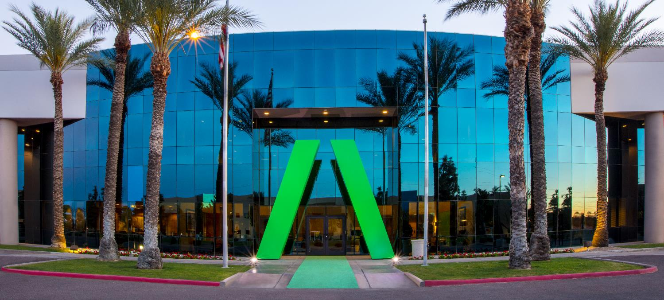
About Avnet
Quick facts
Founded in 1921
Headquartered in Phoenix, Arizona
AVT listed on the NYSE since 1960
AVT listed on NASDAQ since 2018
#181 on FORTUNE 500 (US) in 2025
14,500+
Employees worldwide
2,000+
Engineers around the world
3.3M+
Engineering community members
450K
Customers in
140 countries
250+
Locations
globally
$22.2B
FY25 Revenue
Notes:
As a leading global technology distributor and solutions provider, Avnet has supported customers and suppliers around the world in activating the transformative possibilities of technology.
Avnet is a global company with extensive experience delivering design, supply chain and logistics expertise for customers at every stage of the product lifecycle. We help customers solve challenges anywhere along their product journey, reducing the time, cost and complexities of bringing products to market.
For 100 years, we have continued to expand the breadth and depth of our capabilities through strong supplier relationships, expansion and acquisition. Today, we are headquartered in Phoenix, Arizona, with 14,000+ employees worldwide and 2.1 million customers across the globe.
Our engineers across the globe and 2M+ engineering community members are here to help anyone turn their idea into a product through education, collaboration and high-quality design services.
Then, we’ll help you get that product to market by helping you solve your technology sourcing, manufacturing, supply chain and logistics challenges. We work with customers of every size, in every corner of the world, helping to navigate a simpler path to market.

Slide 20












Avnet Capabilities
Cloud Migration | MAP SPRINTS
Migrate data sets and apps to the cloud securely
AWS AI / ML | Gen AI
Rekognition, SageMaker, Bedrock & more
CORE SEMI | Foundational services
IOT PLATFORM FOR OEMS | Foundational services
Mobile Applications
Powerful mobile apps for global audiences
Server Monitoring
Detect cloud computing and network issues
CLOUD APPLICATION DEVELOPMENT
EMBEDDED SOFTWARE
DESIGN SERVICES
Big Data & Analytics
Scalable and secure big data solutions
DESIGNED BY AVNET
Enterprise Applications
Mission-critical apps running on AWS
EMBEDDED MODULES
& BOARDS
SOLUTIONS DEVELOPMENT:
ADVANCED APPLICATIONS GROUP
Managed Services
Infrastructure management on AWS
Notes:
What makes Avnet unique is we can help customer all along their IoT journey weather it is hardware, software, cloud or supply chain support
The items highlight in red are historical 100 year business associated with electronic components
6 years ago we added software and cloud support so that we could offer complete IoT solutions
In the next slide I will show you how we did this.
It is this full IoT offering from the sensors, micros, connective and embedded software at the edge through the cloud application and SI services that is Avnet’s competitive advantage

Slide 21
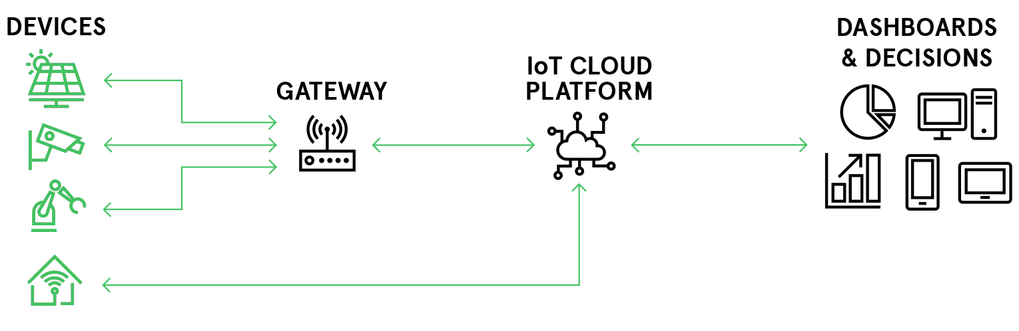
Challenge of IoT
New
Communication Interfaces
Current Generation Product
New IoT Platform
New Hardware Development
Legacy Infrastructure
Mobile App Integration
Developing an IoT product is costly, cumbersome, and time consuming.

Slide 22

Challenge of IoT
With /IOTCONNECT, IoT development becomes simple, secure, and scalable.

Slide 23

Things
Dehumidifiers
In-Wall Moisture Sensors
It takes things like connected dehumidifiers and moisture sensors

Slide 24
Things
Business Insights
Dehumidifiers
extracts
Device Location
In-Wall Moisture Sensors
On-Site Humidity Data
and extracts valuable insights to improve business intelligence

Slide 25
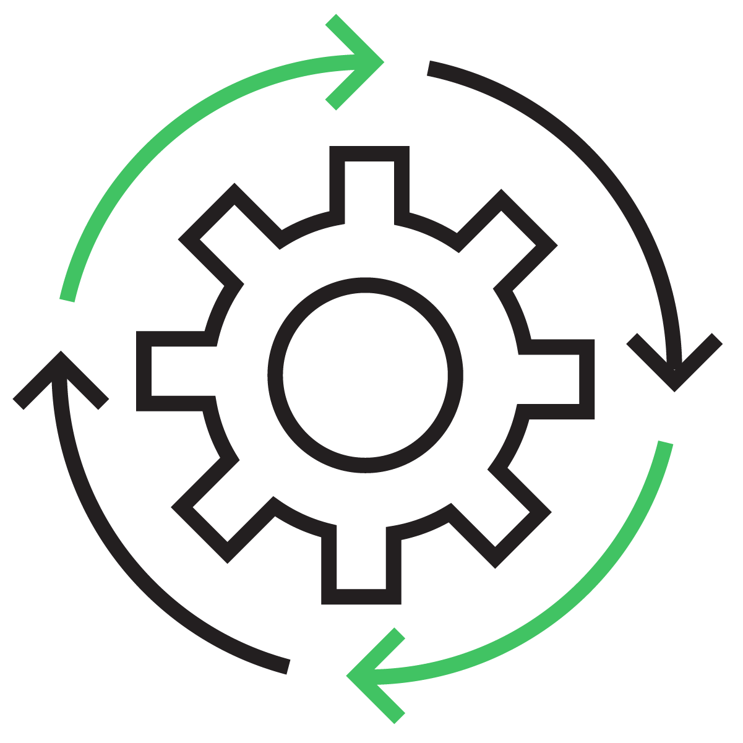



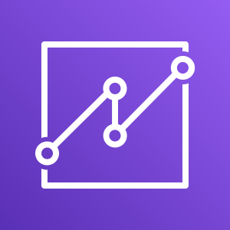

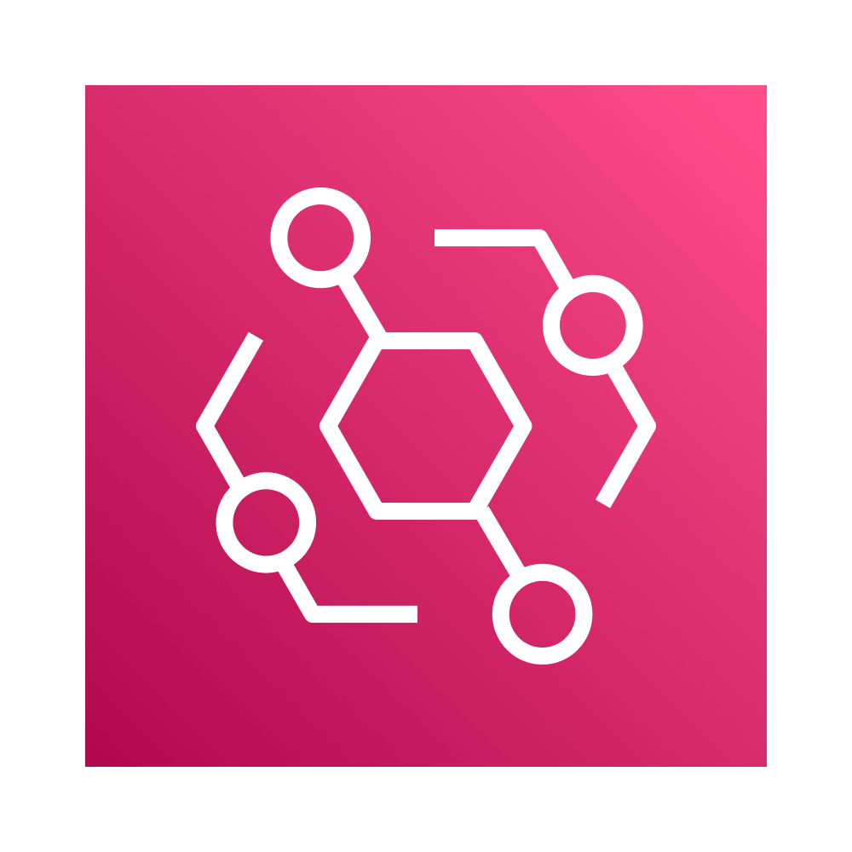

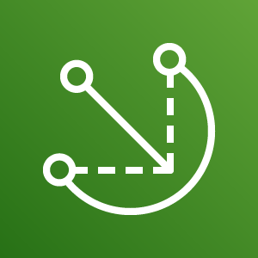

Things
Single Pane of Glass Web Experience
Business Insights
Dehumidifiers
Manage your devices
View and analyze device data
Secure data and devices
Device Location
In-Wall Moisture Sensors
On-Site Humidity Data
Amazon QuickSight
Amazon Simple Storage Service
Amazon EventBridge
Amazon Relational Data Storage
AWS IoT Greengrass
AWS IoT Core
to create a single pane of glass experience
that’s built on AWS

Slide 26
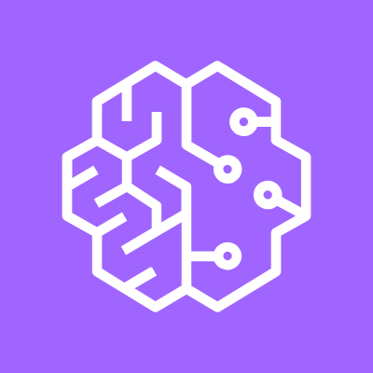





Amazon QuickSight
AWS IoT Core
Amazon SageMaker
AWS IoT Core for Sidewalk
Amazon Kinesis
AWS IoT Core for LoRaWAN
Amazon EventBridge
AWS IoT Greengrass
Amazon Simple Storage Service
Amazon Managed Grafana
Amazon DynamoDB
FreeRTOS
Amazon Relational Data Storage
AWS Lambda
We take needed AWS services for IoT solution development

Slide 27



One interface for AWS services
And aggregate them to create one ecosystem for production ready IoT

Slide 28



/IOTCONNECT SaaS Application in Action

Slide 29
Next Steps

Slide 30


Contact us!
Learn more

Slide 31



Resources
Avnet and AWS:
This is My Architecture
Avnet
/IOTCONNECT Webinar
/IOTCONNECT Quick Start Development Kits

Slide 32




/IOTCONNECT Quick Start Enablement
1
2
3
4
Pick a Board
Access GitHub
Sign up for Free Trial
Start Developing
Access our quick start landing page to look at the variety of developer board options that we have enabled. Select which board fits your need.
Click the GitHub link to see the sample code we have created for each of these developer kits. These include templates and dashboards.
Using the provided link from the quick start guide, sign up for a free /IOTCONNECT account and demo all of the design acceleration features.
With dynamic dashboards and easy onboarding widgets, /IOTCONNECT makes designing for your application simple, secure, and scalable.

Slide 33
Appendix

Slide 34

























IOTCONNECT™ Supports All Devices
AWS IoT Core for
AWS IoT Greengrass
+ Greengrass lite
AWS IoT Core
Services
Device
Types
Connected Devices
Gateway & Child Devices
Private
LoRaWAN
Base Station
Private
LoRaWAN
Concentrator
Public
LoRaWAN
Device
Amazon
Sidewalk
Device
Edge Server or Gateway
Memory Constrained Edge Device
Device
Enablement
AWS IoT Greengrass
/IOTCONNECT™ enables ALL devices types through a single pane of glass.
Notes:
But we also support every different device type that will be required for your application. Whether it’s a directly connected device, a gateway with child elements, LoRaWAN, Edge servers or even memory constrained devices needing nucleus lite, IOTCONNECT supports the device connection through our wide array of communication protocols and languages. If it can be connected to, IOTCONNECT can connect to it. Additionally with all the enablement work that we’ve built within out GitHub library, we’ve made it simple to get started faster than ever.

Slide 35












/IOTCONNECT Building Blocks w/ AWS
/IOTCONNECT Cloud
IoT Device
/IOTCONNECT SDK
Edge Application
& Analytics
Control Path
Data Path
Biz Application
Visualization
Advanced Analytics & AI
FreeRTOS
Python
Greengrass
IoT Core
RDS
QuickSight
SageMaker
Python
C
EventBridge
S3 Data Lake
Grafana
S3
Kinesis
DynamoDB
Lambda
Notes:
An edge to cloud IOT solution involves a great deal of capability AND complexity. As an OEM, driven to deliver connected products today, the task can be daunting and downright intimidating at every step of the journey. Avnet’s silicon providers are using /IOTCONNECT as an easy onboarding mechanism to AWS services. These universal methods make it easy for our joint customers to move from POC to production. Through our partnership with you, we are upping the probability of our suppliers and OEM customers finally achieving scale w/in the IoT

Slide 36

/IOTCONNECT Platform Architecture
Notes:
DIRECT NOTES FROM AWS:
“The platform takes an opinionated approach to the system design with the use of platform specific MQTT topics that saves the customers from doing MQTT topic design. These topics make use of basic ingest to provide cost optimized device to platform interaction. And because each member account on the platform aligns with an AWS account “under the hood”, isolation between customer fleets and access are isolated along AWS account boundaries. This not only removes the need from maintaining isolation at the MQTT broker or IoT Core level, it also reduces the blast radius by ensuring that the usage of one customer cannot affect others on the platform.
Moving up the stack, you will see various Lambda function that are used for managing rules, reporting and persisting data… finally terminating in the application gateway section that enables the consumption and management of fleet data. This interface ultimately enables solution acceleration
Overall, you will see how by leveraging best practices the Avnet and Softweb teams were able to implement an IoT platform that helps customers accelerate their IoT journey. ”

Slide 37








/IOTCONNECT Developer Personas
Device, User, Roles, and Entity Admin
Security manag
Basic dashboarding
Internal Ops
RESTful API
Predictable URLs
Intelligent error handling
OAuth 2.0 authentication
Access to all IoTC functions
Dynamo DB, S3
Signal R
MQTT
Grafana
AWS SNS
Notes:
Users or Developer Pers

Slide 38









/IOTCONNECT SDKs: Deliver a Positive Developer Experience
Objectives:
Deliver device-builders a positive developer-experience
Integrate into the Avnet Supplier's development flow and ecosystem
Provide confidence for a successful outcome at the onset of our customer’s IoT journey
Software Resources
/IOTCONNECT Enablement, Witekio, and Softweb service teams
Access to global and scalable Avnet software services
Skills: C, Python, Java, OS/RTOS, Applications, AI/ML
Deliverables
/IOTCONNECT Library
SDK (C / C# / Python / …)
Test Strategy
Platform Targeted Samples
Developer Guide
QuickStart Experience

Slide 39





















Device Enablement: SDKs
Generic SDKs
Multiple Languages and Environments
Platform-specific SDKs
Development Boards and Embedded Hardware
https://docs.iotconnect.io/iotconnect/sdk/
https://github.com/avnet-iotconnect/
Notes:
Open Links

Slide 40



/IOTCONNECT AWS Demo Examples
AI/ML Audio Classification
Edge ML Voice and Motion Detection
Consumer Indoor Grill

