Slide 1


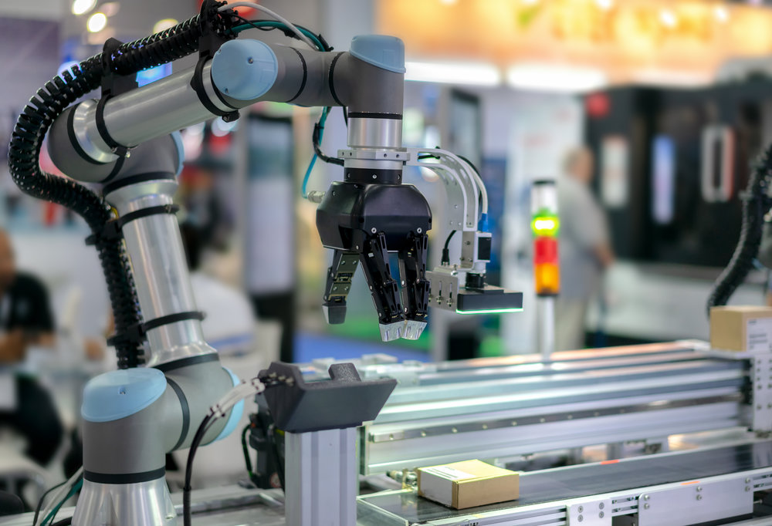
Data Center Operations Automation – Avnet + AWS
Challenges
Automate manual rounds and detect failures before they happen
Avnet /IOTCONNECT Solution
Sensor-driven data center automation on /IOTCONNECT and AWS
Data center operators run their facilities across tools that don’t talk to each other—the BMS tracks cooling, DCIM monitors rack power, SCADA manages electrical systems—while technicians still walk manual rounds. Failures arrive unannounced: a UPS string fails 18 months early, a CRAC outage costs 47 minutes of downtime at roughly $9,000 per minute. Capacity hides in the gap between nameplate and real load, documentation lives in PDFs nobody reads, and energy regulations such as the EU Energy Efficiency Directive demand verifiable PUE figures that manual monthly rollups cannot provide.
Data Center Operations Automation (DCOA) from Avnet and AWS addresses these challenges with sensor-driven intelligence across thermal, power, environmental, and asset systems, built on /IOTCONNECT and AWS. Telemetry from CRAC units, chillers, UPS systems, PDUs, and environmental probes streams through AWS IoT Core and Greengrass into real-time dashboards, predictive alerts, and automated control loops. Edge AI classifies vibration and acoustic signatures on-device to project failures 30–90 days ahead, GenAI-assisted runbooks powered by Amazon Bedrock guide technicians to root cause, and 2D/3D digital twins anchor every alert to its physical location. The platform scales from a single 10,000 sq ft site to large multi-site portfolios.
Benefits
Predictive Maintenance, 30–90 Days Ahead
Vibration, acoustic, temperature, and current-draw signatures are evaluated against site-specific models to project failures weeks ahead, triggering work orders automatically when degradation patterns emerge.
Single Pane of Glass Visibility
Real-time dashboards unify thermal maps, PUE, and asset health across every site—one operator can monitor 160+ devices, drilling from portfolio level to an individual rack or device in three clicks or fewer.
Compliance & Energy, Audit-Ready
Live PUE, WUE, ERF, and REF for EU EED submissions, ASHRAE thermal-envelope monitoring, and automatically timestamped audit trails for SOC 2, ISO 27001, and SLA compliance—with ~40% fewer human-error incidents.
Open Integration Architecture
Contact our IoT experts – mailto:Iot@Avnet.com
Native integration with BMS, DCIM, SCADA, EPMS, CMMS, and ITSM platforms (ServiceNow, Jira SM, Freshservice, GLPI) through open APIs—supporting legacy infrastructure alongside cloud-native systems.
Avnet Contact: Gavin Kirk | Gavin.Kirk@Avnet.com

Slide 2
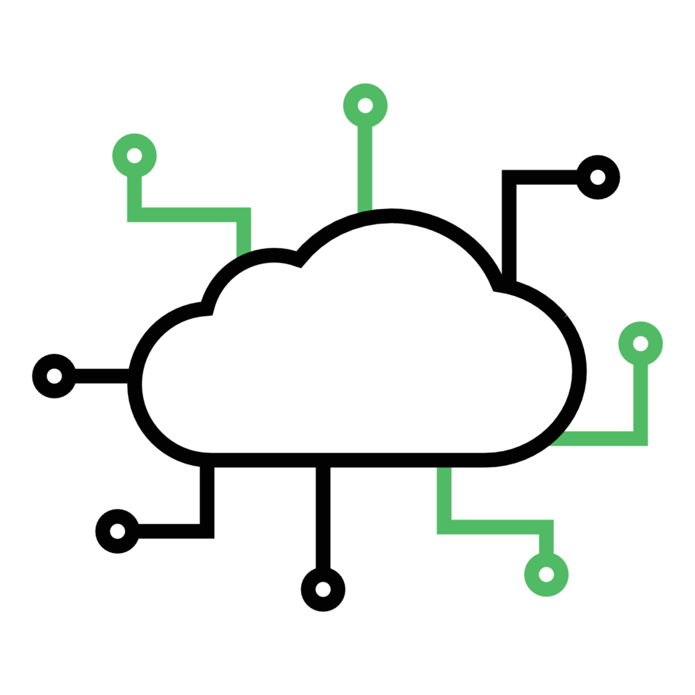
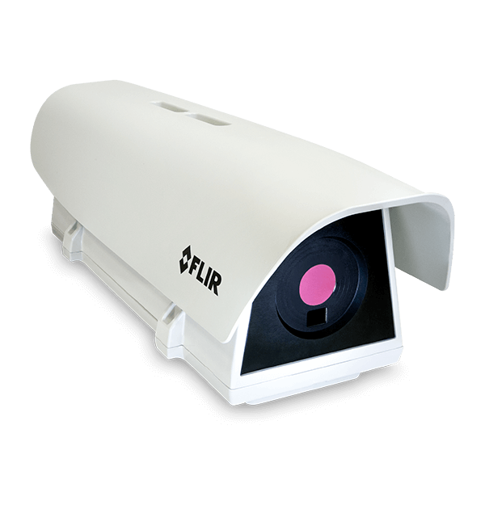
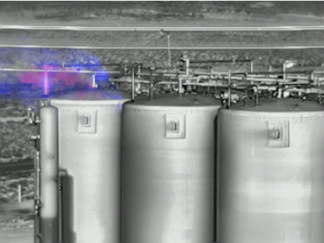
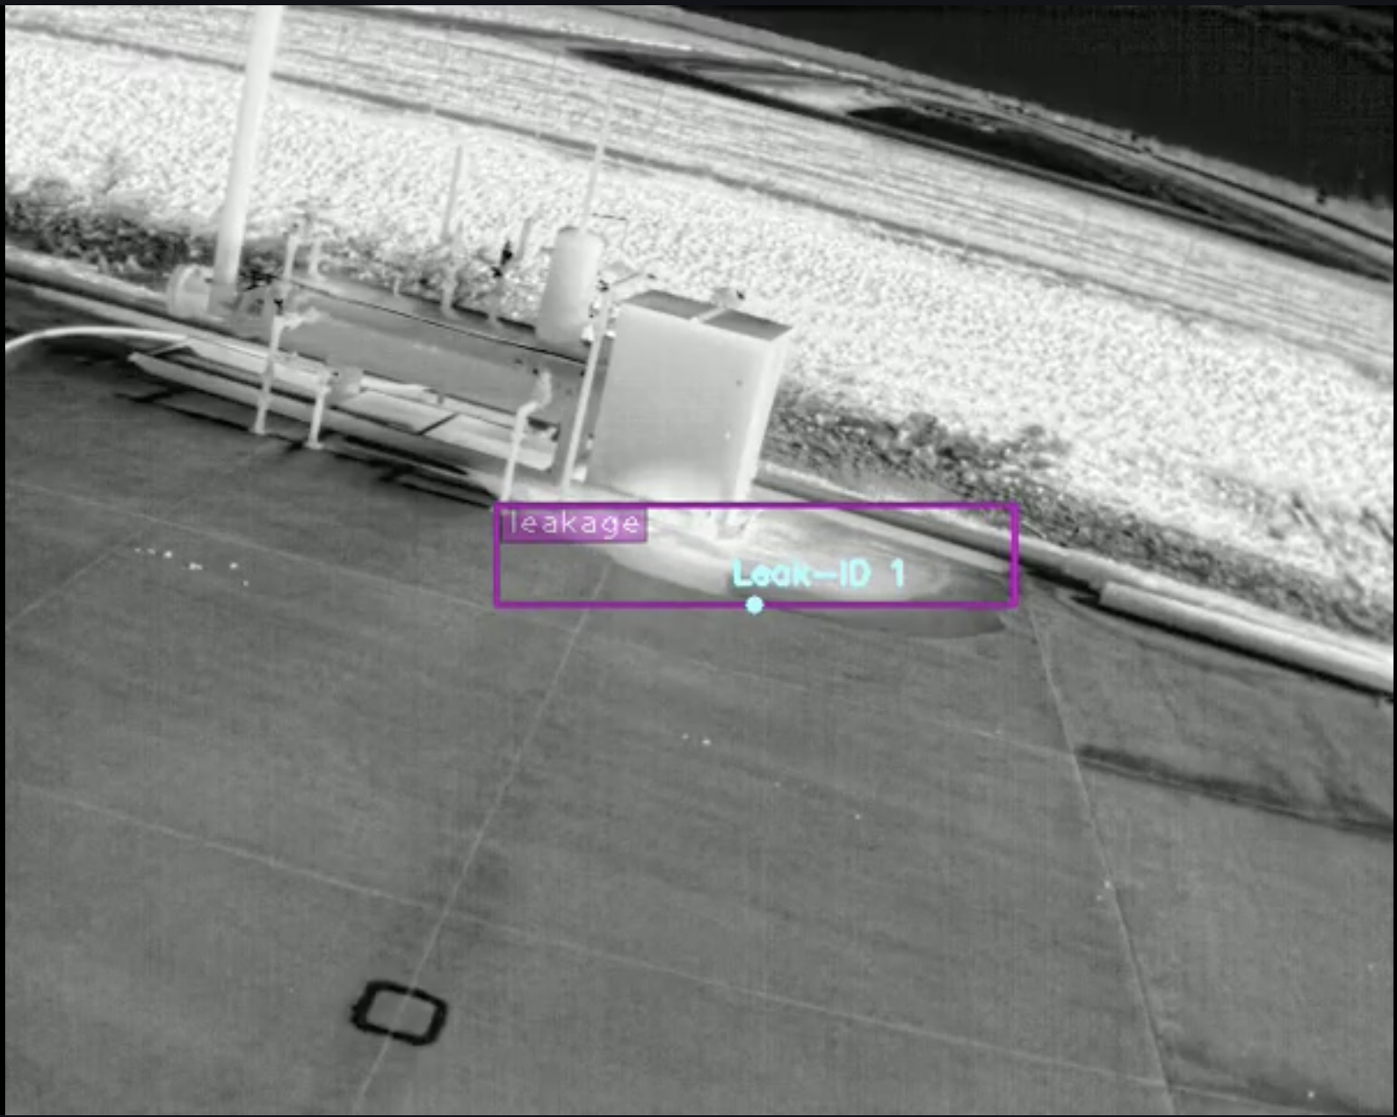
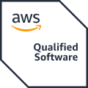
Data Center Automation
Avnet’s Data Center Operations Automation solution, developed with Softweb Solutions (an Avnet company) and AWS, unifies real-time telemetry, predictive maintenance, and digital-twin visualization for data center operators. Built on AWS with /IOTCONNECT as the telemetry backbone, the multi-tenant SaaS platform ingests device data at sub-second latency and delivers persona-specific dashboards for every role from technician to executive.
This solution provides a unified edge-to-cloud architecture for data center operations. AWS IoT Greengrass processes sensor data at the facility for low-latency local alerts, /IOTCONNECT orchestrates devices and data in the cloud, and AWS services—Bedrock, SageMaker, Cognito—power GenAI runbooks, predictive models, and secure role-based access. Together, these capabilities replace manual walkthroughs with continuous monitoring and help operators reach automated, audit-ready operations faster.
Features
This solution is built on three core capabilities that enable scalable data center automation. By combining real-time telemetry, predictive maintenance with digital twins, and unified device management, it provides a seamless foundation for automated, multi-site operations.
1. Real-Time Operations & Telemetry
A sub-second telemetry pipeline with a 23-KPI catalog, an alert-rule engine covering threshold, rate-of-change, and dwell-time conditions, and live PUE dashboards across every power feed.
2. Predictive Maintenance
2D floor plans and 3D digital twins with live telemetry overlays, AI insight streams with quantified confidence, guided rounds, and automated work-order creation.
3. Integrated Device & Data Management (/IOTCONNECT)
Predictive Maintenance
The solution can be purchased through AWS Marketplace with flexible pricing and billing options, making it easier to align costs with project milestones and business needs.
Challenge:
Fragmented BMS, DCIM, and SCADA tools with no shared view
Manual rounds and calendar-based servicing of critical equipment
Unplanned CRAC and UPS failures at ~$9,000 per minute of downtime
Solution:
This solution uses vibration, temperature, and pressure sensors on CRAH units, chillers, AHUs, and cooling towers to detect degradation signals before failure. Runtime-based maintenance triggers replace calendar-interval servicing, AI vision cameras visually confirm anomalies before dispatch, and work orders are created automatically with device context, spec sheets, and manuals attached—projecting failures 30 to 90 days ahead.
/IOTCONNECT is available for subscription and a free trial on AWS Marketplace HERE
Get started with Avnet and AWS Data Center Operations Automation
Contact our IoT experts – mailto:Iot@Avnet.com

